Slide 1
Virtual Machines and Virtualization of Clusters and Data Centers

Slide 2
What is Virtualization?
The Software methods (including hypervisors)used to allow multiple virtual computing resources to run on a single hardware platform.
What is a VM?
A Software Virtualization of a Computer Hardware that executes program like a physical computer and can be interacted with like a physical computer.

Slide 3
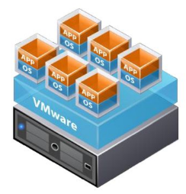
What is VM?
Allows to run Multiple Operating Systems as VMs on a single computer
A VM is a discrete set of files.
Main Files:
Configuration file
Virtual disk file
NVRAM settings file
Log file

Slide 4
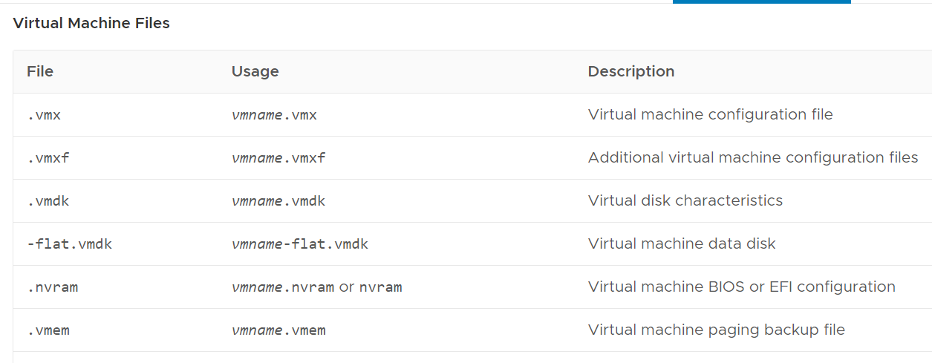
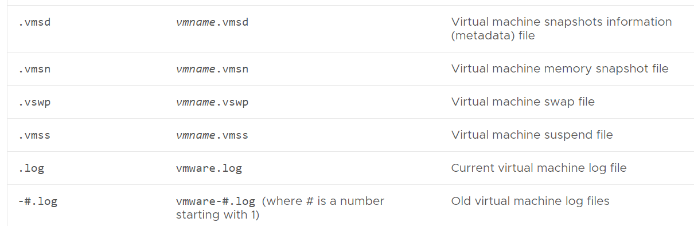

Slide 5
vmx:
The .vmx file describes the current configuration information and hardware settings for the VM.
This can contain a large variety of information regarding the virtual machine, to include its specific virtual hardware configuration (amount of RAM, NIC settings, CD-ROM information, parallel/serial port information, and so on), as well as its advanced resource and power settings,

Slide 6
vmx:
The .vmx file is a plain-text file that functions as the structural definition of the VM.
The .vmx file can be copied from the datastore and opened using a program that supports creation and saving of files using UTF-8 encoding, such as WordPad.

Slide 7
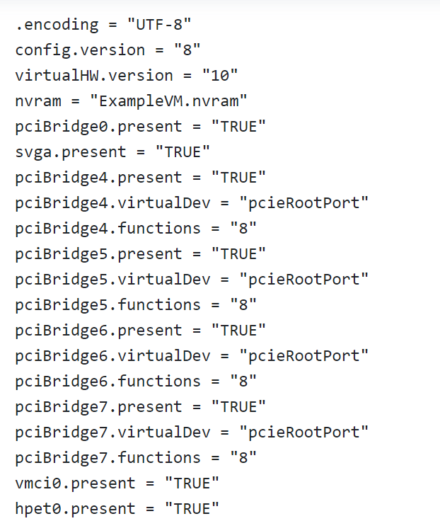
vmx:

Slide 8
.vmtx:
When a virtual machine is converted to a template, the virtual machine configuration file (.vmx) is replaced by the template configuration file (.vmtx).

Slide 9
.nvram:
This is generally a fairly small file that contains the BIOS settings that the VM uses upon boot.
This is similar to how a physical server that has a BIOS chip allows hardware configuration options.
The virtual BIOS settings, contained in the .nvram file, can be accessed by pressing F2 when the virtual machine is powered on.

Slide 10
Virtualization is a computer architecture technology by which multiple virtual machines (VMs) are multiplexed in the same hardware machine.

Slide 11
The purpose of a VM is to enhance resource sharing by many users and improve computer performance in terms of resource utilization and application flexibility.
Hardware resources (CPU, memory, I/O devices, etc.) or
software resources (operating system and software libraries) can be virtualized in various functional layers.

Slide 12
Benefit of Virtualization
Let us assume a system having Multicore Processor with 20 cores
Without Virtualization-
20 cores dedicated to one application
With virtualization =
3 cores to Application A1
3 cores to Application A2
4 cores Application A3
Remaining 10 cores for Host Machine
Resources are shared
Effective Utilization of Resources

Slide 13
Virtualization=Software defined technology
Software defined compute
Software defined networking
Software defined storage

Slide 14
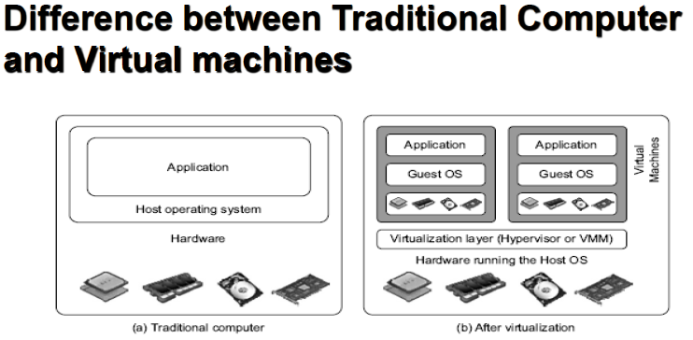
4.1) Virtual Machines

Slide 15
Virtual Machine, Guest Operating System, and VMM (Virtual Machine Monitor) :
VM-
A representation of a real machine using software that provides an operating environment that can run a guest OS
Guest OS-
An operating system running on a VM that would otherwise run on directly on a separate physical system.
VMM-
The Virtualization Layer is the middleware between the VM and the underlying Host platform , also called as Virtual Machine Monitor or VMM.

Slide 16
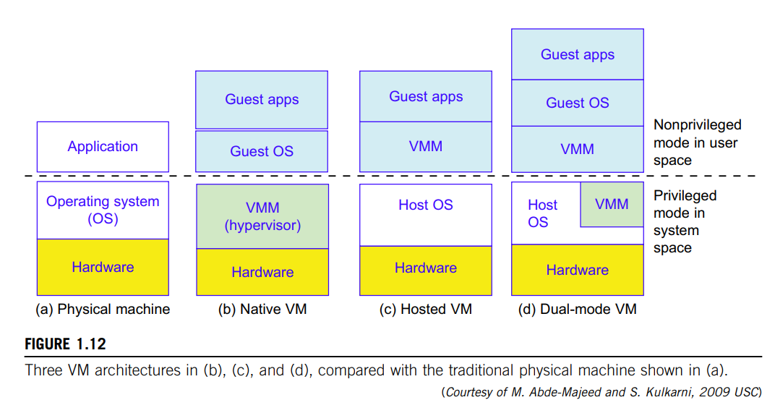
Virtual Machine Architecture
Three VM Architecture (b),(c),(d) compared with the traditional physical machine in (a)

Slide 17
a)Physical Machine
A host machine is equipped with the physical hardware
Eg- x-86 architecture desktop running its installed Windows OS

Slide 18
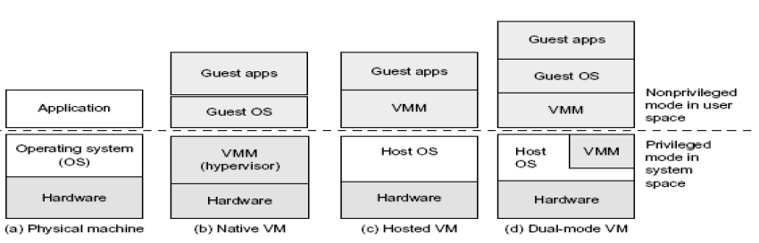
(b) Native VM approach
A native VM installed with the use of a VMM called a hypervisor in privileged mode
This Hypervisor handles the bare hardware(CPU, memory, I/O) directly, hence called as Bare Metal Hypervisor or Native VM
Eg-
The guest OS could be a Linux system and the hypervisor the XEN system developed at Cambridge University.

Slide 19
(c)Hosted VM Approach
The Host OS needs not to be modified.
Here the VMM runs in non-privileged mode.

Slide 20
(d)Dual Mode VM Approach
Part of the VMM runs at the user level and another part runs at the supervisor level.
In this case, the host OS may have to be modified to some extent.

Slide 21
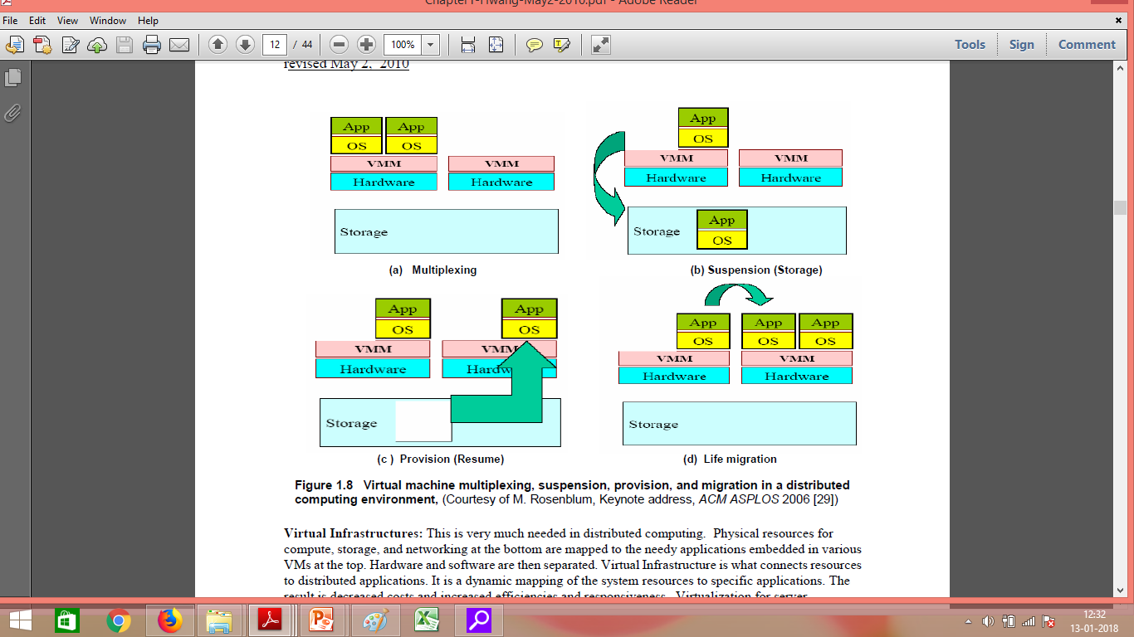
Primitive Operations in Virtual Machines:

Slide 22
Primitive Operations in Virtual Machines:
VMs can be multiplexed b/w hardware m/c
A VM can be suspended and stored in stable storage
A suspended VM can be resumed or provisioned to a new hardware platform.
You suspend a virtual machine when you want to save its current state.
When you resume the virtual machine, applications that were running before the virtual machine was suspended resume in their running state and their content is unchanged.
A VM can be migrated from one hardware platform to another.

Slide 23
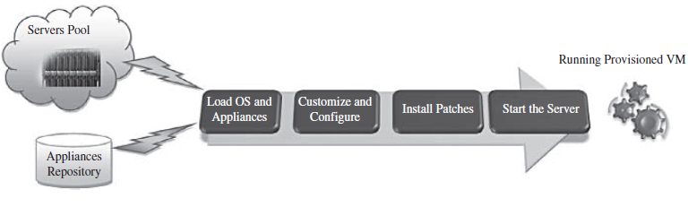
Provisioning VM
The steps of provisioning a Virtual Machine are:
Firstly, you need to select a server from a pool of available servers along with appropriate OS template you need to provision the VM
Secondly, you need to load the appropriate software(OS you selected in the previous step, device drivers, middleware and the needed applications for the service required).

Slide 24
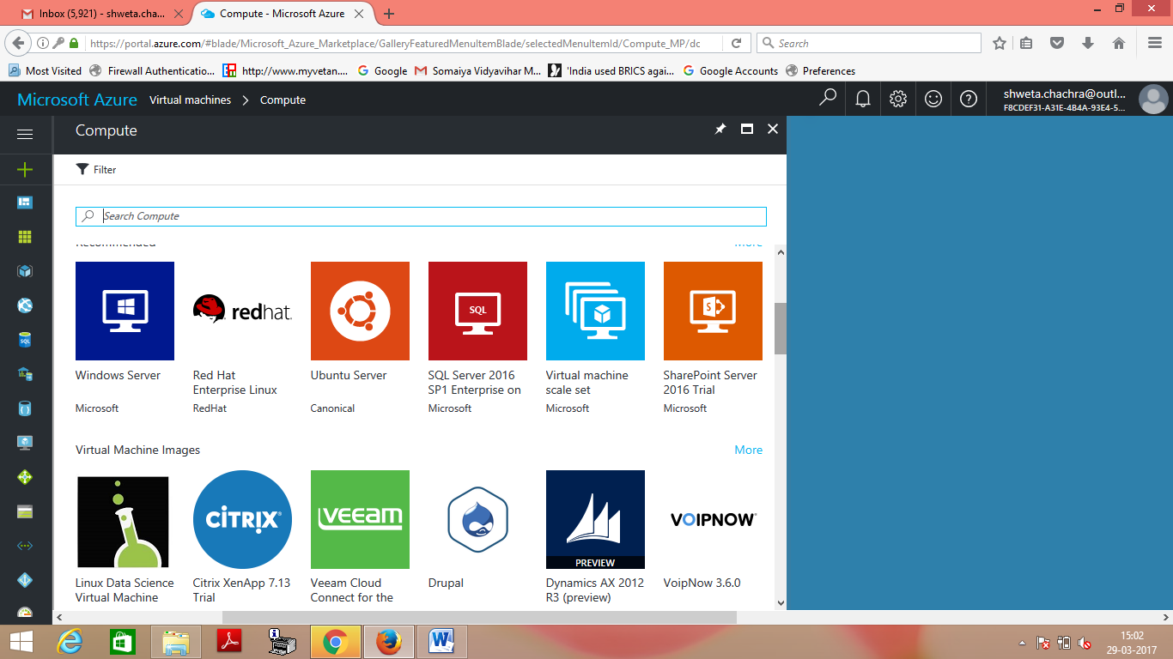
Eg-Selecting a server in Microsoft Azure

Slide 25
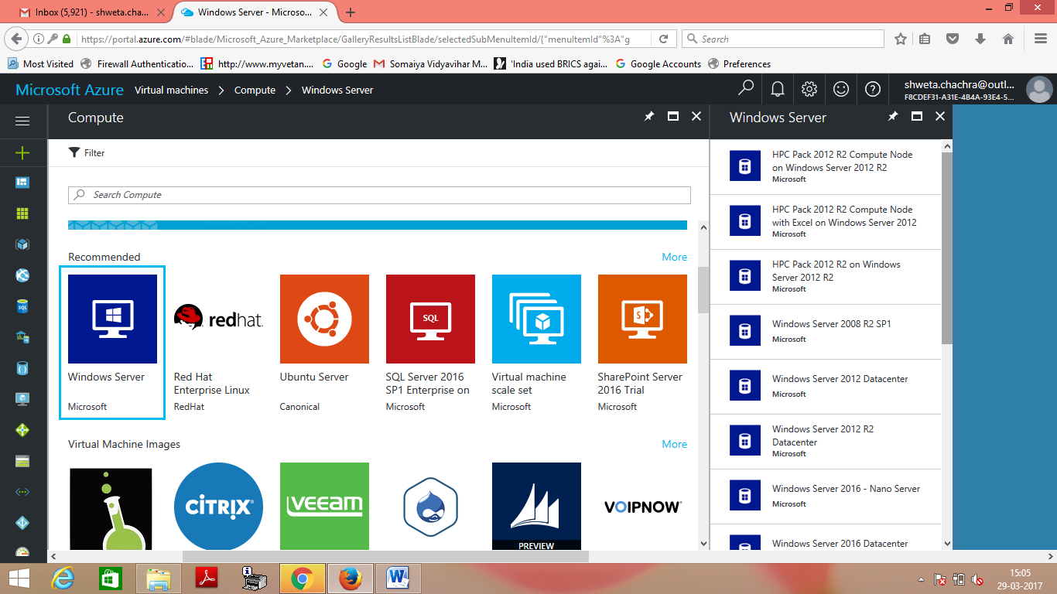
Eg-Then Selecting an OS in Microsoft Azure

Slide 26
Provisioning VM
Thirdly, you need to customize and configure the M/c(eg:IP address, Gateway) to configure an associated n/w and storage resources.
Finally, the VM is ready to start with its newly loaded software.

Slide 27
Live Migration What?
Hot Migration
Real-Time Migration
Movement of a virtual m/c from one physical host to another while being powered on.
Transparently move running Virtual Machines from one host to another without perceived downtime.

Slide 28
Live Migration When?
During a planned maintenance event on a virtual machine (VM) instance's underlying hardware, Compute Engine might move the VM to another host.
To keep a VM running during a host event, Compute Engine performs a live migration of the VM to another host in the same zone.

Slide 29
Live Migration
When it is properly carried out,
this process takes place without any noticeable effect from the end user’s point of view(a matter of milliseconds).
Live migration is automatically started by strategies such as load balancing and server consolidation.
Can also be used for load balancing
work is shared among computers
to optimize the utilization of available CPU Resources.

Slide 30
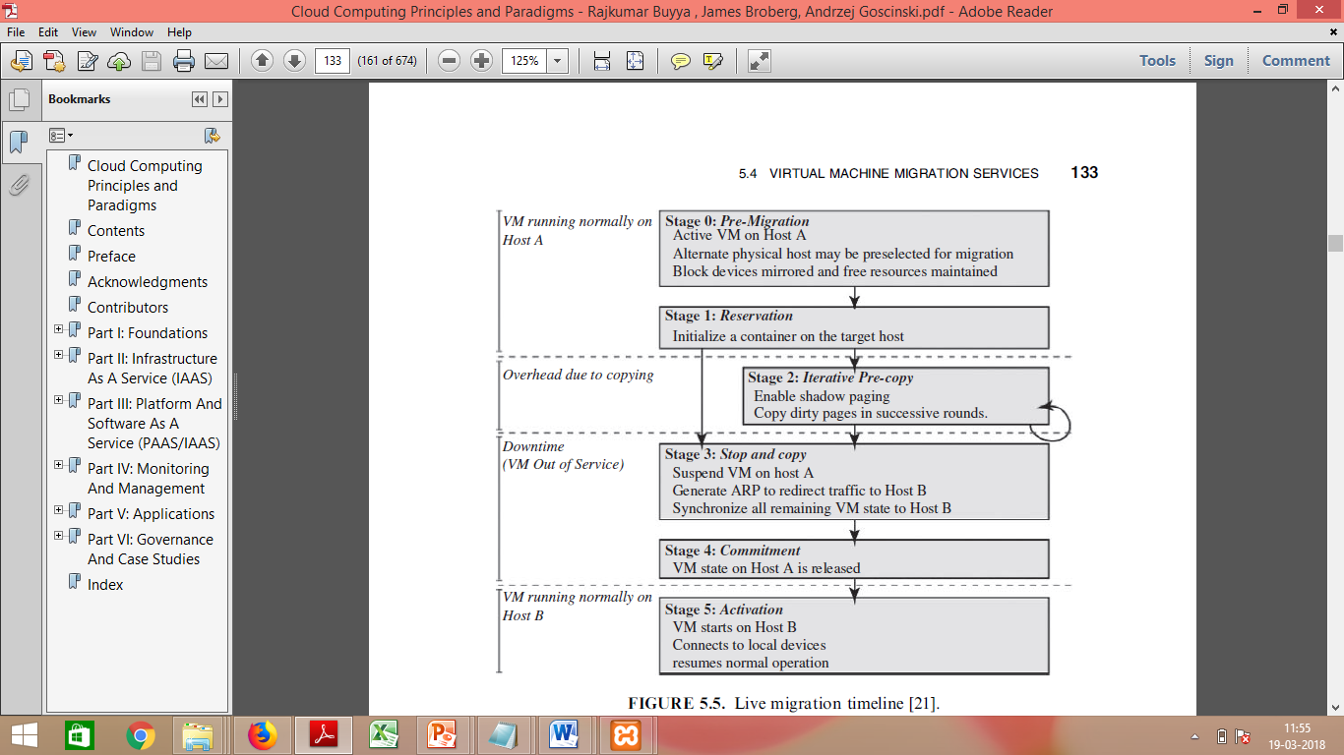
Live Migration How?

Slide 31
Live Migration
Stage 0:Pre Migration:
Preparatory step
Determining the migrating VM and the destination host
An Active VM exists on the physical host A.
Alternate physical host may be selected for migration

Slide 32
Live Migration
Stage 1:Reservation:
A request is issued to migrate an OS from host A to host B
A precondition is that the necessary resources exist on B and has a VM container of that size

Slide 33
Live Migration
Stage 2:Iterative precopy:
Since the whole execution state of the VM is stored in memory,
sending the VM’s memory to the destination node ensures continuity of the service provided by the VM.

Slide 34
Live Migration
Stage 2:Iterative precopy:
During the first iteration,
all memory pages are transferred from A to B.
Subsequent iterations
copy only those memory pages dirtied during the previous transfer phase.

Slide 35
Live Migration
Stage 3: Stop and Copy:
Running OS instance at A is suspended
Network traffic is redirected to B.
Other non-memory data such as CPU and network states should be sent as well.
CPU state and any remaining inconsistent memory pages are then transferred.

Slide 36
Live Migration
Stage 3: Stop and Copy:
During this step, the VM is stopped and its applications will no longer run.
This “service unavailable” time is called the “downtime” of migration, which should be as short as possible so that it can be negligible to users

Slide 37
Live Migration
Stage 3: Stop and Copy:
At the end of this stage, there is
A consistent suspended copy of the VM at both A and B.
The copy at A is considered primary
Resumed in case of failure.

Slide 38
Live Migration
Stage 4:Commitment:
Host B indicates to A that it has successfully received a consistent OS image.
Host A acknowledges this message as a commitment of the migration transaction.

Slide 39
Live Migration
Stage 4:Commitment:
Host A may now discard the original VM
Host B becomes the primary host.

Slide 40
Live Migration
Stage 5:Activation:
The migrated VM on B is now activated.
Post Migration code runs to
reattach the device drivers to the new m/c and
Then the network connection is redirected to the new VM

Slide 41
Live Migration
Stage 5:Activation:
After all the needed data is copied, on the destination host,
The VM reloads the states and recovers the execution of programs in it, and the service provided by this VM continues.

Slide 42
Live Migration
Atleast One host has a consistent VM image at all times during migration.

Slide 43
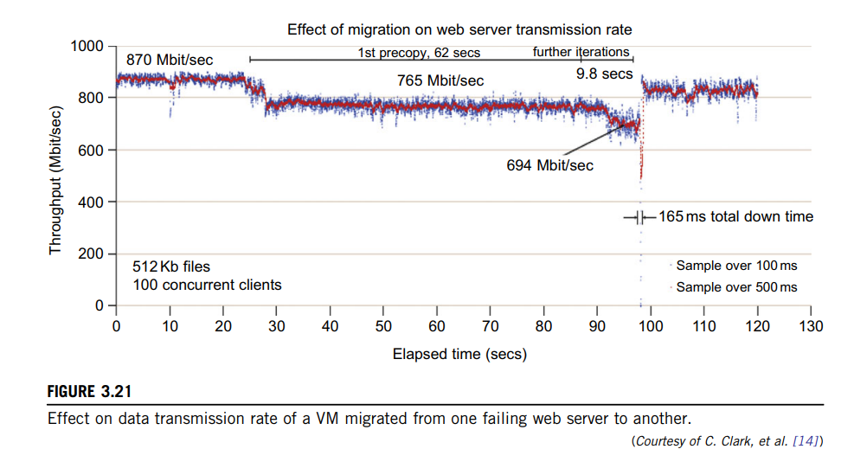
The Figure shows the effect on the data transmission rate (Mbit/second) of live migration of a VM from one host to another.

Slide 44
Before copying the VM with 512 KB files for 100 clients, the data throughput was 870 MB/second.
The first precopy takes 62 seconds, during which the rate is reduced to 765 MB/second.
Then the data rate reduces to 694 MB/second in 9.8 seconds for more iterations of the copying process.
The system experiences only 165 ms of downtime, before the VM is restored at the destination host.

Slide 45
This experimental result shows a very small migration overhead in live transfer of a VM between host nodes.
This is critical to achieve dynamic cluster reconfiguration and disaster recovery as needed in cloud computing.

Slide 46
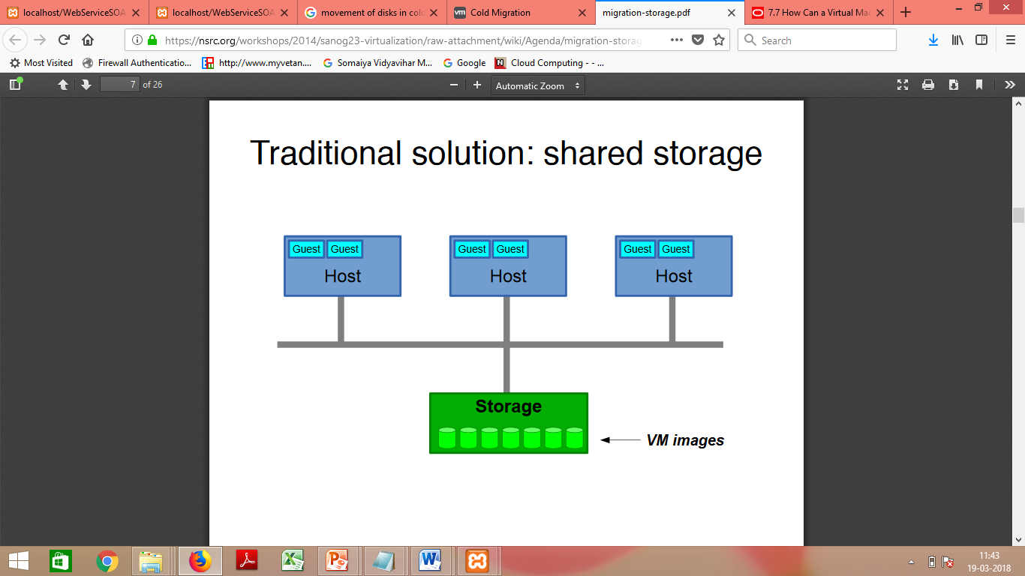
Regular/Cold Migration
Cold migration is the migration of a powered-off virtual machine.
With cold migration, you have the option of moving the associated disks from one data store to another.
In Cold Migration, The virtual machines are not required to be on a shared storage.

Slide 47
Regular/Cold Migration
The two main differences b/w live migration and cold migration are:
Live migration needs a shared storage for virtual machines in the server’s pool, but cold migration does not; also,
In live migration for a virtual machine between two hosts, there would be certain CPU compatibility checks to be applied; while in cold migration these checks do not apply.

Slide 48
Regular/Cold Migration
The cold migration process is simple to implement ,can be summarized as follows:
The configuration files, including the NVRAM file (BIOS settings), log files, as well as the disks of the virtual machine, are moved from the source host to the destination host’s associated storage area.
The virtual machine is registered with the new host.
After the migration is completed, the old version of the virtual machine is deleted from the source host.

Slide 49
Applications of Migration
??

Slide 50
Applications of Migration
Load balancing:
When?

Slide 51
Applications of Migration
Load balancing:
Move VMs to a less busy host
Make use of newly-added capacity

Slide 52
Applications of Migration
Failure
How?

Slide 53
Applications of Migration
Load balancing:
Move VMs to a less busy host
Make use of newly-added capacity
Recovery from host failure
Restart VM on a different host

Slide 54
Applications of Migration
Maintenance
How?

Slide 55
Applications of Migration
Load balancing:
Move VMs to a less busy host
Make use of newly-added capacity
Recovery from host failure
Restart VM on a different host
Maintenance
Planned Shutdown:
Move VMs off a host before it is shut down

Slide 56
Levels of Virtualization Implementation
The main function of the software layer for virtualization is to virtualize the physical hardware of a host machine into virtual resources to be used by the VMs, exclusively.
This can be implemented at various operational levels.

Slide 57
Levels of Virtualization Implementation
The virtualization software creates the abstraction of VMs by interposing a virtualization layer at various levels of a computer system.

Slide 58
Levels of Virtualization Implementation
Common virtualization layers include the
Instruction set architecture (ISA) level
Hardware level
Operating system level
Library support level
Application level

Slide 59
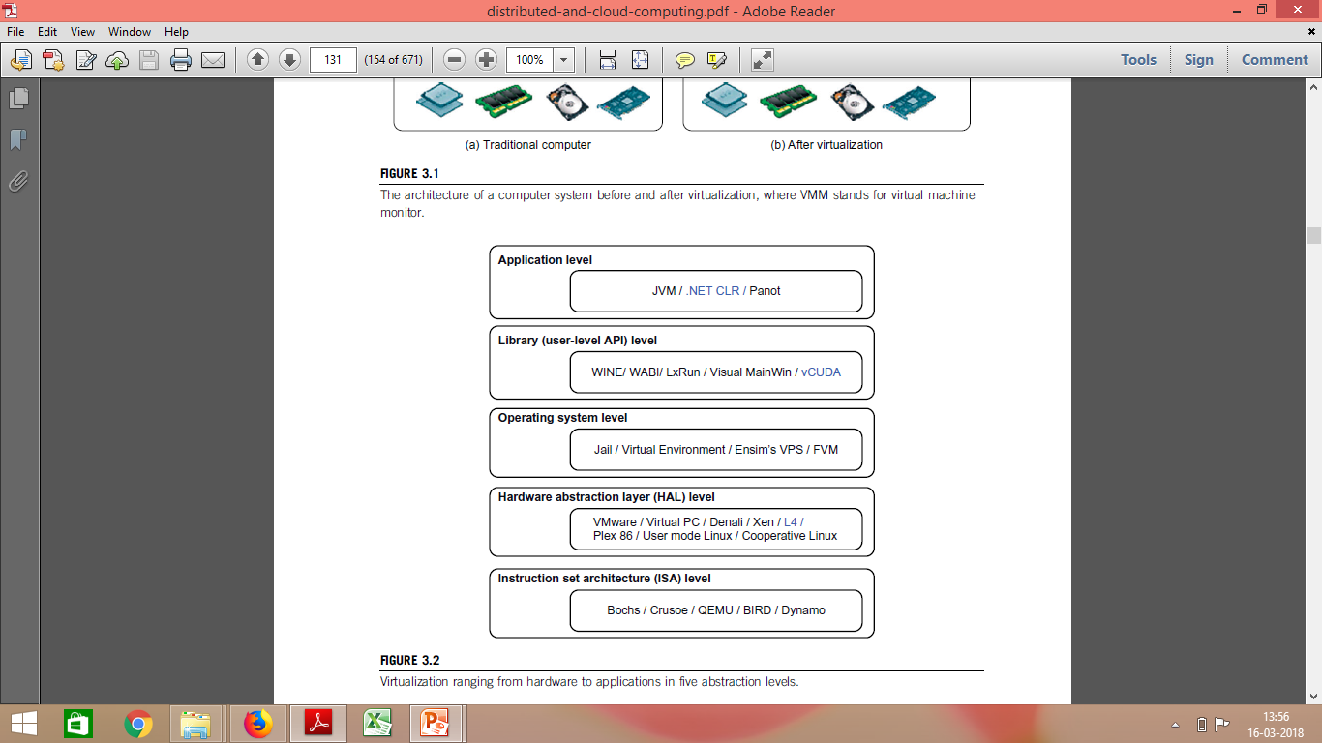
Levels of Virtualization Implementation

Slide 60
Instruction Set Architecture Level

Slide 61
What is an Instruction Set?

Slide 62
What is an Instruction Set?
The instruction set provides commands to the processor, to tell it what it needs to do.

Slide 63
What is an Instruction Set?
The instruction set provides commands to the processor, to tell it what it needs to do.
The instruction set consists of
addressing modes,
operation,
native data types,
registers,
memory architecture,
interrupt, and
exception handling, and
external I/O.

Slide 64
Code Sequence C = A + B Instruction Set
Accumulator | Register (register-memory) | Register (load-store)
Load A Add B Store C | Load R1, A Add R1, B Store C, R1 | Load R1,A Load R2, B Add R3, R1, R2 Store C, R3

Slide 65
What is an Instruction Set?
Example-
x86 instruction set, which is common to find on computers today.
is a family of complex instruction set computer (CISC) instruction set architectures initially developed by Intel based on the Intel 8086 microprocessor and its 8088 variant.
Both the Intel Pentium and AMD Athlon processors use nearly the same x86 instruction set.
Different computer processors can use almost the same instruction set while still having very different internal design.

Slide 66
Instruction Set Architecture Level
Virtualization –
Transforming the physical architecture of the system’s instruction set completely into software.

Slide 67
Instruction Set Architecture Level
The guest systems issue instructions for the emulator to process and execute.
The instructions are received by the emulator, which transforms them into a native instruction set.
The native instructions are run on the host m/c’s hardware.
The instructions include both the processor-oriented instructions and the I/O specific ones.

Slide 68
At the ISA level, virtualization is performed by emulating a given ISA by the ISA of the host machine.
For example,
MIPS binary code can run on an x86-based host machine with the help of ISA emulation.

Slide 69
MIPS (Microprocessor without Interlocked Pipelined Stages) is a family of reduced instruction set computer (RISC) instruction set architectures (ISA) developed by MIPS Technologies, based in the United States.
There are multiple versions of MIPS: including MIPS I, II, III, IV, and V; as well as five releases of MIPS32/64 (for 32- and 64-bit implementations, respectively).

Slide 70
Instruction Set Architecture Level
The basic emulation method is through code interpretation.
An interpreter program interprets the source instructions to target instructions one by one.
One source instruction may require tens or hundreds of native target instructions to perform its function.
Obviously, this process is relatively slow.

Slide 71
Instruction Set Architecture Level
For better performance, dynamic binary translation is desired.
This approach translates basic blocks of dynamic source instructions to target instructions to increase translation efficiency.
Instruction set emulation requires binary translation and optimization.
A virtual instruction set architecture (V-ISA) thus requires adding a processor-specific software translation layer to the compiler

Slide 72
Instruction Set Architecture Level
Advantage:
Enables the host system to adjust to a change in the architecture of the guest system, if accomplishing a task can be possible through the instructions that are available with the host system.

Slide 73
Instruction Set Architecture Level
Advantage:
The infrastructure provided by the virtualization of this kind can be used for creating VMs on a platform.
For eg- x86 on any platform such a x86,Sparc or Alpha etc.
With this approach, it is possible to run a large amount of legacy binary code written for various processors on any given new hardware host machine.

Slide 74
Instruction Set Architecture Level
Disadvantage:
The instructions need to be interpreted before being executed.
An interpreter program interprets the source instructions to target instructions one by one.
Therefore the system with the virtualization at ISA level shows a poor performance.
One source instruction may require tens or hundreds of native target instructions to perform its function. Obviously, this process is relatively slow.

Slide 75
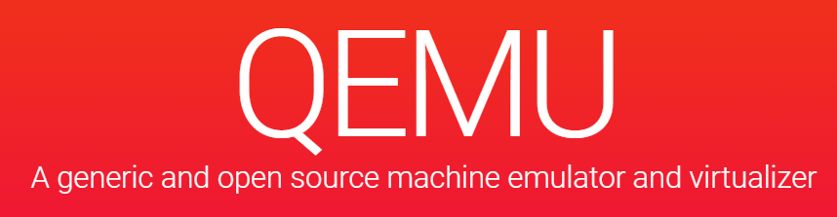
Qemu
QEMU is a generic and open source machine emulator and virtualizer.
Run operating systems for any machine, on any supported architecture

Slide 76
Hardware Abstraction Level WHAT?
Virtualization is performed right
“on top of the bare hardware.”
On the one hand, this approach generates a virtual hardware environment for a VM.
On the other hand, the process manages the underlying hardware through virtualization

Slide 77
Hardware Abstraction Level WHAT?
The idea is to virtualize a computer’s resources, such as its:
Processors
memory, and
I/O devices.
The intention is to upgrade the
hardware utilization rate by multiple users concurrently.

Slide 78
Virtualization at Hardware Abstraction level: WHAT?
Typical systems: VMware, Virtual PC, Denali, Xen

Slide 79
Virtualization at Hardware Abstraction level: WHAT?
Example-
The Xen hypervisor has been applied to virtualize x86-based machines to run Linux or other guest OS applications.

Slide 80
Hardware Abstraction Level(Privileged Instructions) WHAT?
What are Privileged Instructions?
The Instructions that can run only in Kernel Mode are called Privileged Instructions
Privileged instructions by VMs
Execution of privileged instructions need full attention of CPU.
If not managed properly by the VMM, will raise an exception resulting into system crash.
Advantages:-
Trapping and forwarding the privileged instructions to VMM helps in managing a system properly, thereby
avoiding various risks and
keeping individual virtual m/cs isolated.

Slide 81
Hardware Abstraction Level(Privileged Instructions) HOW?
Hardware Level virtualization needs
trapping the execution of privileged instructions by the virtual m/c,
which must pass these instructions to the VMM for being handled properly

Slide 82
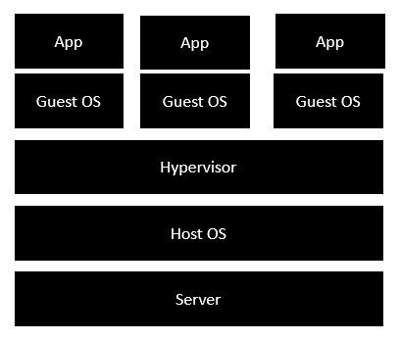
Hardware Abstraction Level(Privileged Instructions) HOW?
This is required because of the possible existence of multiple virtual machines,
each having its own OS that might issue separate privileged instructions.

Slide 83
Virtualization at Hardware Abstraction level :
It supports multiple OSs and applications to be run simultaneously which require
no system reboot or dual-boot setup.
It gives the appearance of
multiple separate m/cs each of which can be used as a normal system.
The degree of isolation is high, whereas
implementation is less risky and maintenance is easy.

Slide 84
Virtualization at Hardware Abstraction level:
However, this technique permits you to have access to a raw computer
which requires a lot of time to be spent in the installation and administration of the virtual system
before you can think of testing or running applications.
In case the physical and virtual Oss are the same,
It results in duplication of your efforts, which should be avoided for an efficient use of the system.

Slide 85
Hardware Abstraction Level
Advantage: has higher performance and good application isolation
Shortcoming & limitation: very expensive to implement (complexity)

Slide 86
Virtualization at Operating System level:
To overcome the issues of redundancy and time consumption
we implement virtualization at a higher level, i.e. virtualization at the level of the OS.
In case the physical and virtual Oss are the same,
It results in duplication of your efforts, which should be avoided for an efficient use of the system.

Slide 87
Virtualization at Operating System level:
It is an “abstraction layer between traditional OS and user applications.”

Slide 88
Virtualization at Operating System level:
Typical systems: Jail / Virtual Environment / Ensim's VPS / FVM

Slide 89
Traditional Virtualization
•Server is the physical server that is used to host multiple virtual machines.
•Host OS is the base machine such as Linux or Windows.
•Hypervisor is either VMWare or Windows Hyper V that is used to host virtual machines.
•One would then install multiple operating systems as virtual machines on top of the existing hypervisor as Guest OS.
•One would then host your applications on top of each Guest OS.

Slide 90
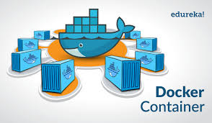
Dockers
Dockers containers are analogous to physical containers that you can use to store, package, and transport goods.
But instead of tangible goods, they’re containers for software applications.

Slide 91
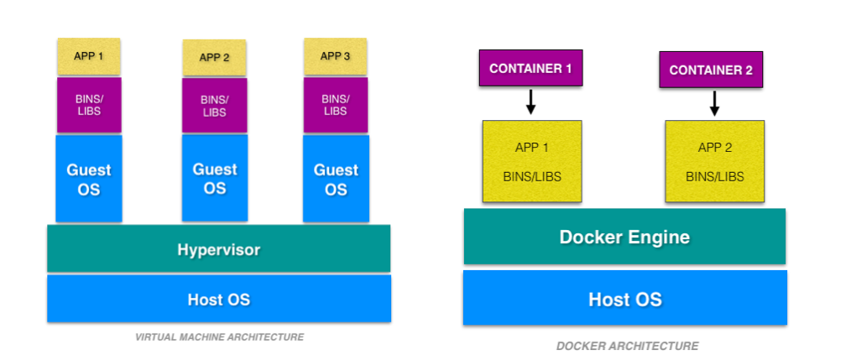
Dockers
A container is an environment that runs an application that is not dependent on the operating system.

Slide 92
What is a Container?
A docker container is a portable unit of software—
that has the application
along with the associated dependency and configuration.
The kernel of the host operating system serves the needs of running different functions of an app, separated into containers.

Slide 93
What is a Container?
Each container runs isolated tasks.
It cannot harm the host machine nor
come in conflict with other apps running in separate containers.

Slide 94
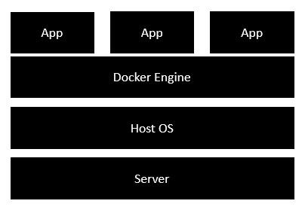
Docker – Architecture
•Docker engine-
is used to virtualize the guest operating system which earlier used to run in virtual machines
•All of the Apps now run as Docker containers.

Slide 95
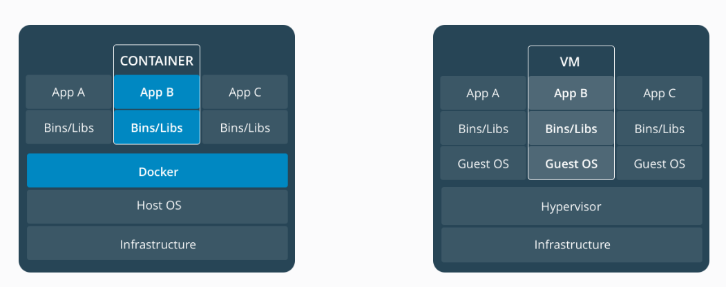
Containers vs Virtual Machines
Container
VM

Slide 97
Virtual Machines and Containers
Virtual machines run guest operating systems - the OS layer in each box.
Resulting disk image and application state is
an entanglement of OS settings,
system-installed dependencies,
OS security patches

Slide 98
Virtual Machines and Containers
•Containers can share a single kernel, and the only information that needs to be in a container image is the executable and its package dependencies, which never need to be installed on the host system.
•These processes run like native processes, and can be managed individually
•Because they contain all their dependencies, there is no configuration entanglement;
A containerized app “runs anywhere”

Slide 99
Operating System Level
The containers behave like real servers.
OS-level virtualization is commonly used in creating virtual hosting environments to
allocate hardware resources among a large number of mutually distrusting users.

Slide 100
Library Support Level
Most applications use APIs exported by user-level libraries rather than using lengthy system calls by the OS.

Slide 101
APIs?
What?
API can be thought of as a contract of service between two applications. This contract defines how the two communicate with each other using requests and responses.

Slide 102
APIs?
How do APIs work?
API architecture is usually explained in terms of client and server.
The application sending the request is called the client, and the application sending the response is called the server.
In the weather example, the bureau’s weather database is the server, and the mobile app is the client.

Slide 103
APIs?
How do APIs work?
There are four different ways that APIs can work depending on when and why they were created.
SOAP APIs
These APIs use Simple Object Access Protocol. Client and server exchange messages using XML. This is a less flexible API that was more popular in the past.
RPC APIs
These APIs are called Remote Procedure Calls. The client completes a function (or procedure) on the server, and the server sends the output back to the client.
Websocket APIs
Websocket API is another modern web API development that uses JSON objects to pass data.
REST APIs
These are the most popular and flexible APIs found on the web today. REST defines a set of functions like GET, PUT, DELETE, etc. that clients can use to access server data. Clients and servers exchange data using HTTP.

Slide 104
APIs?
APIS are used to
Enable programmers to write programs easily.
Most systems provide well-documented APIs,
This is taken as another candidate for virtualization.

Slide 105
Library level virtualization
Also called
User-level Application Binary Interface (ABI) or
API emulation.

Slide 106
Library level virtualization
It is done by API call interception and remapping.
Create execution environments for running alien programs on a platform
rather than creating a VM to run the entire operating system.
Typical systems: Wine, WAB, LxRun , VisualMainWin

Slide 107
Library Support Level
Virtualization with library interfaces is possible by controlling the communication link between applications and the rest of a system through API hooks.
The software tool WINE has implemented this approach to support Windows applications on top of UNIX hosts.
https://www.winehq.org/

Slide 108
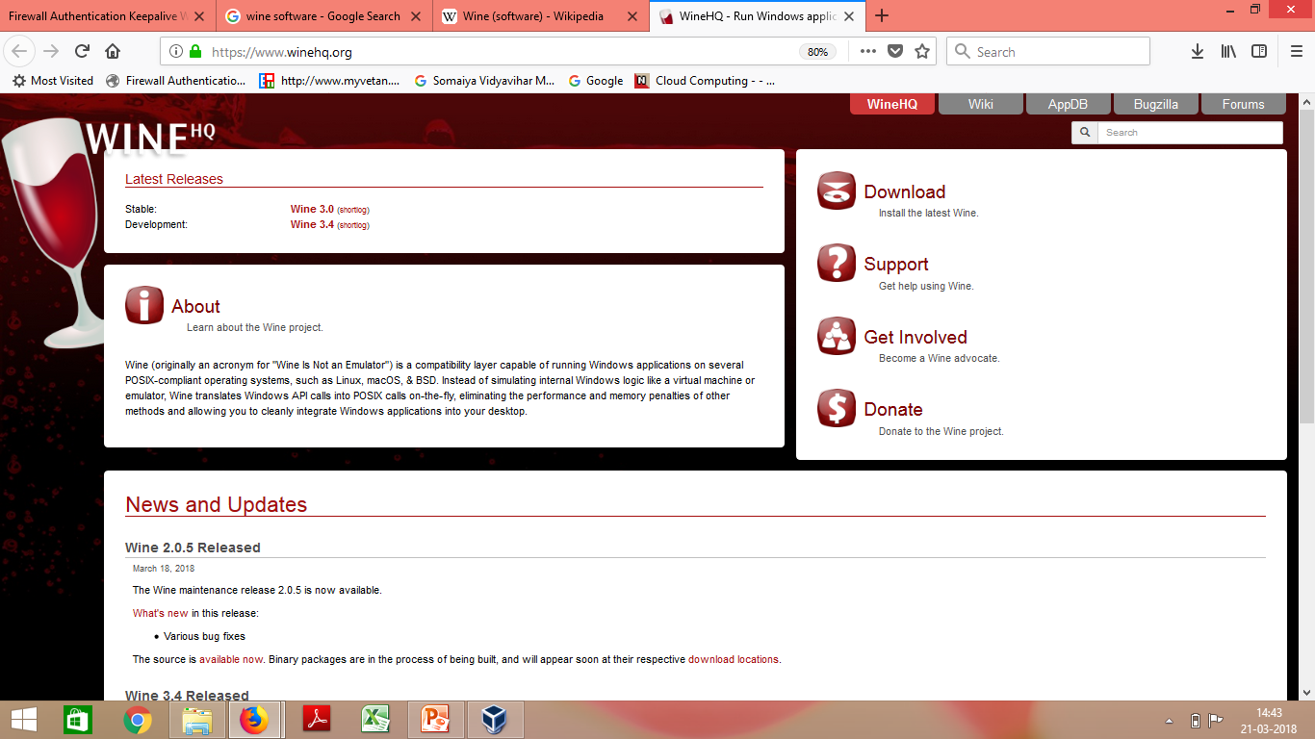
WINE
https://www.winehq.org/
Screenshot:

Slide 109
WINE
Wine (recursive backronym for Wine Is Not an Emulator)
A free and open-source compatibility layer that aims to allow
computer programs developed for Microsoft Windows
to run on Unix-like operating systems.

Slide 110
WINE
Instead of simulating internal Windows logic like a virtual machine,
Wine translates Windows API calls into POSIX((Portable Operating System Interface) calls on-the-fly,
eliminating the performance and memory penalties of other methods and
allowing you to cleanly integrate Windows applications into your desktop.

Slide 111
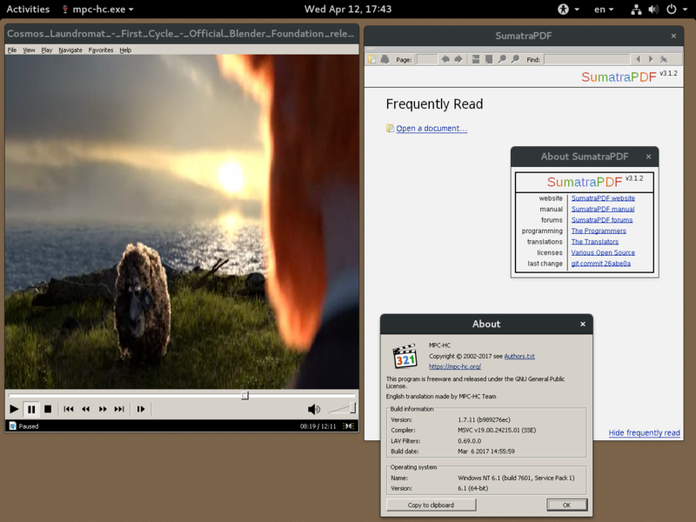
WINE v2.0.5 running Sumatra PDF and Media Player Classic on Fedora

Slide 112
Library Support level:
Another example is the vCUDA which allows applications executing within VMs to leverage GPU hardware acceleration.

Slide 113
Library Support level:
Advantage: It has very low implementation effort
Shortcoming & limitation: poor application flexibility and isolation

Slide 114
User-Application Level
Application level virtualization
Virtualizes an application as a VM.
On a traditional OS, an application often runs as a process. Thus known as Process-level virtualization.

Slide 115
User-Application level:
High level language (HLL) VMs
The virtualization layer sits as
an application program on top of an operating system and
exports an abstraction of a VM that can run programs which are written and compiled to that particular abstract machine definition.
Any program written in the HLL and compiled for this VM will run on it.

Slide 116
User-Application level:
The Microsoft .NET CLR and Java Virtual Machine (JVM) are two good examples of this class of VM.
The arrival of Java Virtual Machine(JVM) brought a new dimension to virtualization.

Slide 117
User-Application Level
This type of VM has become popular with the Java programming language, which is implemented using the Java virtual machine.
Other examples include the .NET Framework, which runs on a VM called the Common Language Runtime.

Slide 118
JVM
A Java virtual machine (JVM) is a virtual machine that enables a computer to run Java programs as well as programs written in other languages but compiled to Java bytecode.

Slide 119
Revisiting facts about Java
The Compiler of java called as javac converts source code into a Intermediate file known as Bytecode file.
The Bytecode file is platform independent
The Interpreter of java (java) converts Bytecode into the specific OS compatible machine code . This code will vary according to OS.
Java interpreter:
The Java interpreter decodes and executes bytecode for the Java virtual machine.
The Java interpreter is actually a part of JVM.
Virtual machine is not just executing the bytecodes, it has lot of tasks to do. That full-fledged environment is referred to as a JVM.

Slide 120
JVM
The Java Virtual Machine is responsible for interpreting Java byte code and translating this into actions or Operating System calls.
For example, a request to establish a socket connection to a remote machine will involve an Operating System call.
Different Operating Systems handle sockets in different ways - but the programmer doesn't need to worry about such details.

Slide 121
Stack based VMs
Both JVM and . NET CLI are stack based VMs.
Based on Execution stack that is used to perform operations.

Slide 122
Stack based VMs
The byte code generated by compilers for these architectures
contains a set of instructions that load operand on the stack, perform some operations with them and put the result on the stack.

Slide 123
Register based VMs
An alternative based on registers.
Example- Parrot, A programming Language VM originally designed to support execution of PERL and then generalized to host the execution of dynamic languages.

Slide 124
Application virtual machine
A process VM,
also called an application virtual machine, or
Managed Runtime Environment (MRE),
runs as a normal application inside a host OS and supports a single process.
It is created when that process is started and destroyed when it exits.
Its purpose is to provide a platform-independent programming environment and allows a program to execute in the same way on any platform.

Slide 125
User-Application Level
Other forms of application-level virtualization are:
application isolation
application streaming.
The process involves wrapping the application in a layer that is isolated from the host OS and other applications.
The result is an application that is much easier to distribute and remove from user workstations.

Slide 126
What is LANDesk?
An example of application virtualization.

Slide 127
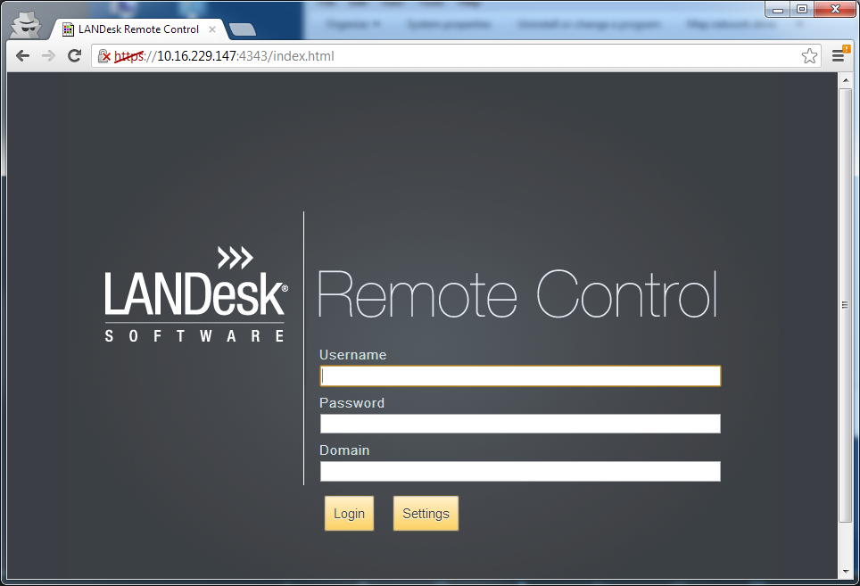
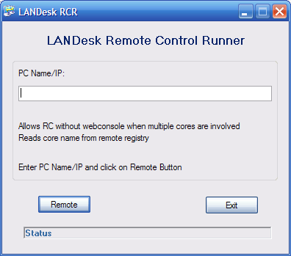
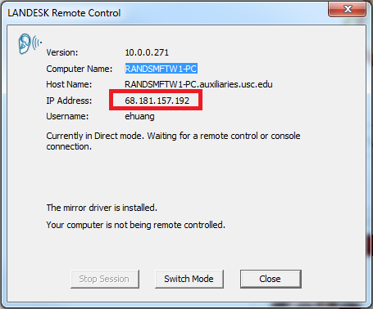
What is LANDesk?

Slide 128
What is LANDesk?
LANDESK's Remote Control capabilities allow IT departments to minimize downtime by
Fixing computer errors and updating systems from a remote location.
LANDesk is an asset management software system used to
remotely inventory and manage desktop computers.
Reports on installed software and hardware, allow remote assistance, and install operating system security patches.

Slide 129
User-Application Level
Advantage: has the best application isolation
Shortcoming & limitation: low performance, low application flexibility and high implementation complexity.

Slide 130
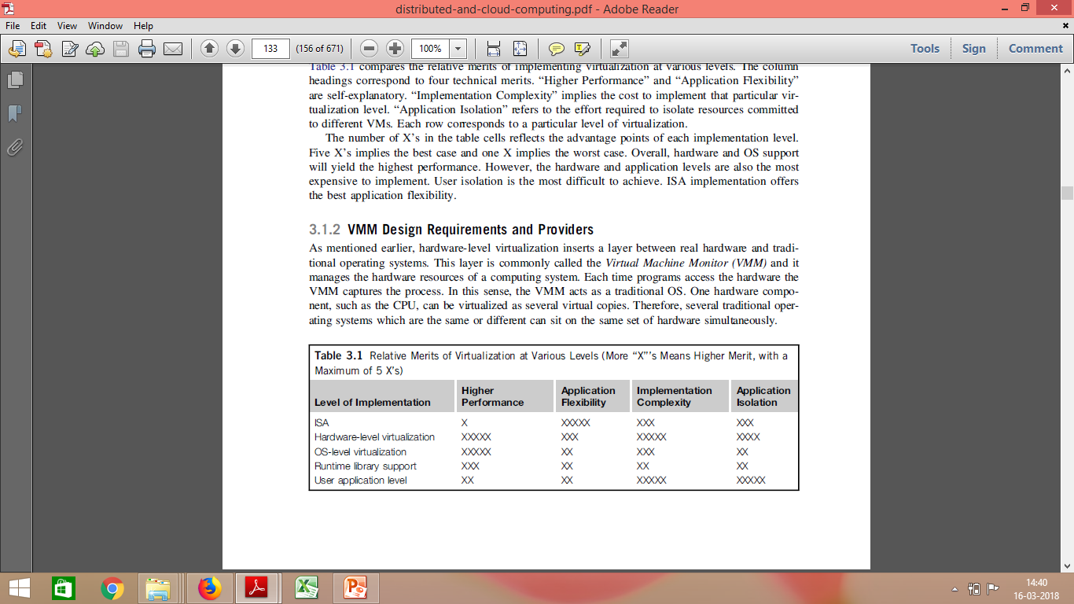
Relative Merits of Different Approaches
The number of X’s in the table cells reflects the advantage points of each implementation level.
Five X’s implies the best case and one X implies the worst case.

Slide 131
Relative Merits of Different Approaches
Overall, hardware and OS support will yield the highest performance.
However, the hardware and application levels are also the most expensive to implement.
User isolation is the most difficult to achieve.
ISA implementation offers the best application flexibility.

Slide 132
Virtualization Design Requirements
Equivalence Requirement
Efficiency Requirement
Resource Control requirement

Slide 133
Virtualization Design Requirements
Equivalence Requirement
A m/c that is developed through virtualization must have a logical equivalence with the real m/cs :
Needs to match the capabilities of the physical system in its computational performance.
How??

Slide 134
Virtualization Design Requirements
Equivalence Requirement
A m/c that is developed through virtualization must have a logical equivalence with the real m/cs :
Needs to match the capabilities of the physical system in its computational performance.
To execute all the applications and programs that are designed to execute on the real m/cs.

Slide 135
Virtualization Design Requirements
Efficiency Requirement
While taking the route of Virtualization,
the virtual m/c must be as efficient in its performance as a real system.
Virtualization is primarily done with a purpose of getting efficient software
without the physical hardware.

Slide 136
Virtualization Design Requirements
Resource Control requirement
A typical computer system is a combination of various resources, including processors, memory, and I/O devices.
All these resources must be managed and controlled effectively by the VMM.
The VMM must be in a state of enforcing isolation between the virtualized systems.

Slide 137
VIRTUALIZATION STRUCTURES/TOOLS AND MECHANISMS Hypervisor
Hypervisor and Xen Architecture
Binary Translation with Full Virtualization
Para-Virtualization with Compiler Support

Slide 138
VIRTUALIZATION STRUCTURES/TOOLS AND MECHANISMS Hypervisor
The hypervisor supports hardware-level virtualization on bare metal devices like CPU, memory, disk and network interfaces.

Slide 139
Hypervisors
A hypervisor is a hardware virtualization technique allowing multiple operating systems, called guests to run on a host machine.
This is also called the Virtual Machine Monitor (VMM).

Slide 140
Hypervisors
Essentially, a hypervisor must be able to convert physical devices into virtual resources dedicated for the deployed VM to use

Slide 141
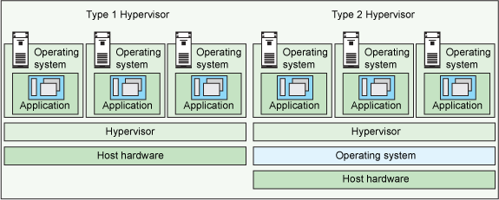
Hypervisors
There are two types of hypervisors:
Type 1 hypervisor:
hypervisors run directly on the system hardware – A “bare metal” embedded hypervisor,
Type 2 hypervisor:
hypervisors run on a host operating system that provides virtualization services, such as I/O device support and memory management.

Slide 142
Type 1 Hypervisors
Type 1 hypervisor or the bare metal hypervisor
Sits on the bare metal computer hardware like the CPU, memory, etc.
All the guest operating systems are a layer above the hypervisor.
So the hypervisor is the first layer over the hardware.
The original CP/CMS hypervisor developed by IBM was of this kind.
Examples are Microsoft Hyper-V

Slide 143
Type 2 Hypervisors
Type 2 or the hosted hypervisor
Does not run over the bare metal hardware but they run over a host operating system.
The hypervisor is the second layer over the hardware.
The guest operating systems run a layer over the hypervisor and so they form the third layer.
Examples are FreeBSD.

Slide 144
Architectures of Hypervisor
Hypervisor can have 2 architectures:
a micro-kernel architecture
a monolithic hypervisor architecture

Slide 145
Architectures of Hypervisor
A micro-kernel hypervisor
includes only the basic and unchanging functions (such as physical memory management and processor scheduling).
The device drivers and other changeable components are outside the hypervisor.
A monolithic hypervisor
implements all the aforementioned functions, including those of the device drivers.
Size of the hypervisor code of a micro-kernel hypervisor is smaller than that of a monolithic hypervisor.

Slide 146
Architectures of Hypervisor
Micro-kernel architecture like the Microsoft Hyper-V.
Monolithic hypervisor architecture like the VMware ESX for server virtualization

Slide 147
The Xen Architecture Where & What?
Developed by Cambridge University.
Xen started as an Open source Hypervisor project.
Xen is a Type 1 Hypervisor

Slide 148
The Xen Architecture
Xen is a microkernel hypervisor,
Does not include any device drivers natively.
It just provides a mechanism by which a guest OS can have direct access to the physical devices.
As a result, the size of the Xen hypervisor is kept rather small.

Slide 149
The Xen Architecture
It separates the policy from the mechanism.
Xen hypervisor implements all the mechanisms,
leaving the policy to be handled by Domain 0

Slide 150
The Xen Architecture Where & What?
A base to other virtualization products both
commercial and open source.
Xen currently forms the base of commercial hypervisors of a number of vendors,
most notably XenSource by Citrix.

Slide 151
Usage?
Xen based technology is used for either
Desktop virtualization
Server virtualization
Recently for Cloud computing Solutions with Xen Cloud Platform

Slide 152
How?
Core technology=Xen Hypervisor
Primarily Based on Paravirtualization.
Paravirtualization:
Modifying portion of the guest operating system by Xen
Recently Xen has been advanced to support full virtualization using hardware assisted virtualization.

Slide 153
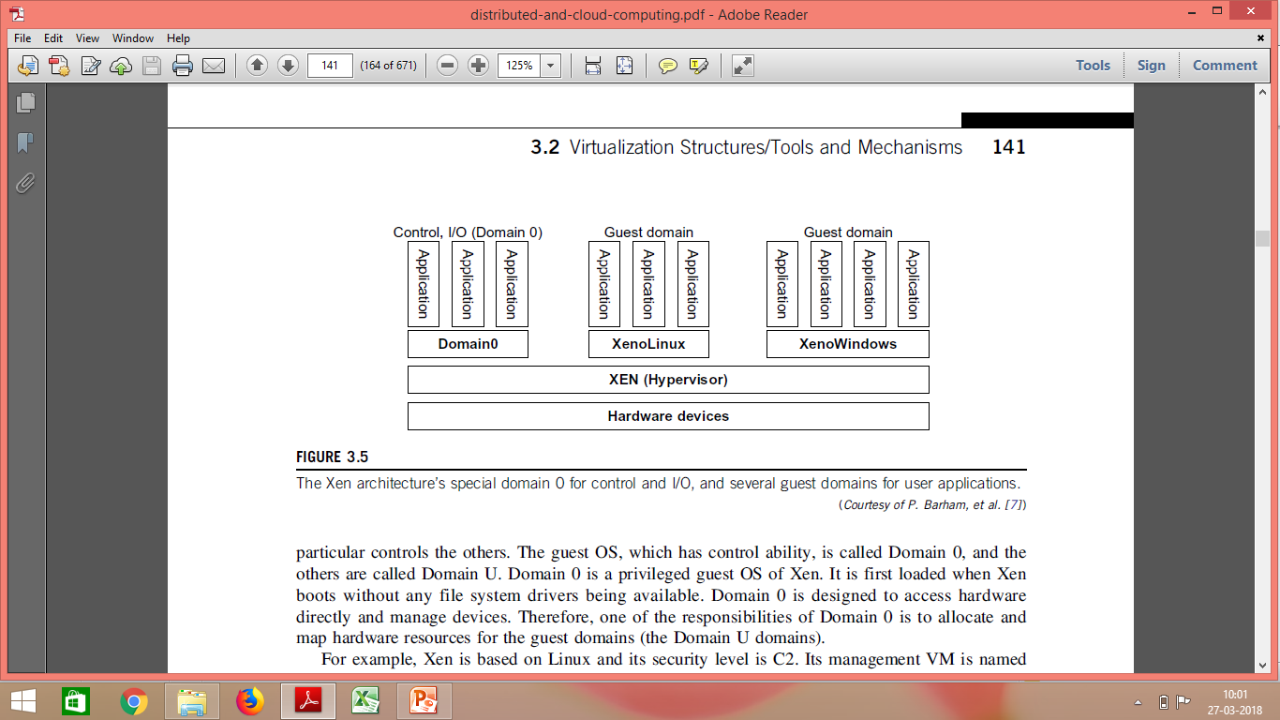
The Xen Architecture

Slide 154
The Xen Architecture
The core components of a Xen system are
the hypervisor
kernel,
applications.
The organization of the three components is important.

Slide 155
The Xen Architecture
Many guest OSes can run on top of the hypervisor.
Not all guest OSes are created equal, and
One in particular controls the others.

Slide 156
The Xen Architecture
The guest OS, which has control ability, is called Domain 0
The others are called Domain U.

Slide 157
What is a Domain?
Guest operating systems are executed within Domains which represent VMs instances.
They are of 2 types:
Domain O
Domain U

Slide 158
Domain 0
Specific Control Software
Controls all the other guest operating systems ,
is executed in a special domain called Domain 0.
Privileged guest OS of Xen
Privileged access to the host
Also called Management VM
As it has the privilege to manage other VMs implemented on the same host.

Slide 159
Domain 0
It is first loaded when Xen boots without any file system drivers being available.
Domain 0 is designed to access hardware directly and manage devices.
Therefore, one of the responsibilities of Domain 0 is to allocate and map hardware resources for the other guest domains(Domain U)

Slide 160
How does Domain 0 Work?
The first one that is loaded once the VMM has been completely booted.
It Hosts an HTTP server that serves requests for VM creation, configuration, migrate, suspension, resume and termination.
Domain 0, behaving as a VMM, allows users to create, copy, save, read, modify, share, migrate, and roll back VMs as easily as manipulating a file

Slide 161
Security of Domain 0
If Domain 0 is compromised, the hacker can control the entire system.
Security policies are needed to improve the security of Domain 0.
The Series of security problems during the software life cycle and data lifetime have to be handled.

Slide 162
Domain U
All the other domains running guest operating systems are called Domain U

Slide 163
HyperCalls
“The hypervisor provides hypercalls for the guest OSes and applications. “
Sensitive system calls need to be re-implemented with hypercalls.
The Xen hypervisor is able to catch the execution of all the sensitive instructions manage them and return the control to the guest operating system by means of a handler.

Slide 164
Full Virtualization with Binary Translation

Slide 165
Full Virtualization
With full virtualization, non-critical instructions run on the hardware directly while
critical instructions are discovered and replaced with traps into the VMM to be emulated by software.

Slide 166
Full Virtualization
Why are only critical instructions trapped into the VMM?
Non-critical instructions
do not control hardware or
do not threaten the security of the system, but critical instructions do.
Running noncritical instructions on hardware not only
can promote efficiency,
but also can ensure system security.

Slide 167
Full Virtualization: Why only CI?
FV relies on binary translation to trap and to virtualize the execution of certain sensitive, non-virtualizable instructions.

Slide 168
Popek and Goldberg Instructions
The Popek and Goldberg virtualization requirements are a set of conditions sufficient for a computer architecture to support system virtualization efficiently.
They were introduced by Gerald J. Popek and Robert P. Goldberg in their 1974 article "Formal Requirements for Virtualizable Third Generation Architectures".
A convenient way of determining whether a computer architecture supports efficient virtualization and provide guidelines for the design of virtualized computer architectures.

Slide 169
Popek and Goldberg Instructions
Privileged instructions
Those that trap if the processor is in user mode and do not trap if it is in system mode (supervisor mode).
Control sensitive instructions
Those that attempt to change the configuration of resources in the system.
Behavior sensitive instructions
Those whose behavior or result depends on the configuration of resources (the content of the relocation register or the processor's mode).

Slide 170
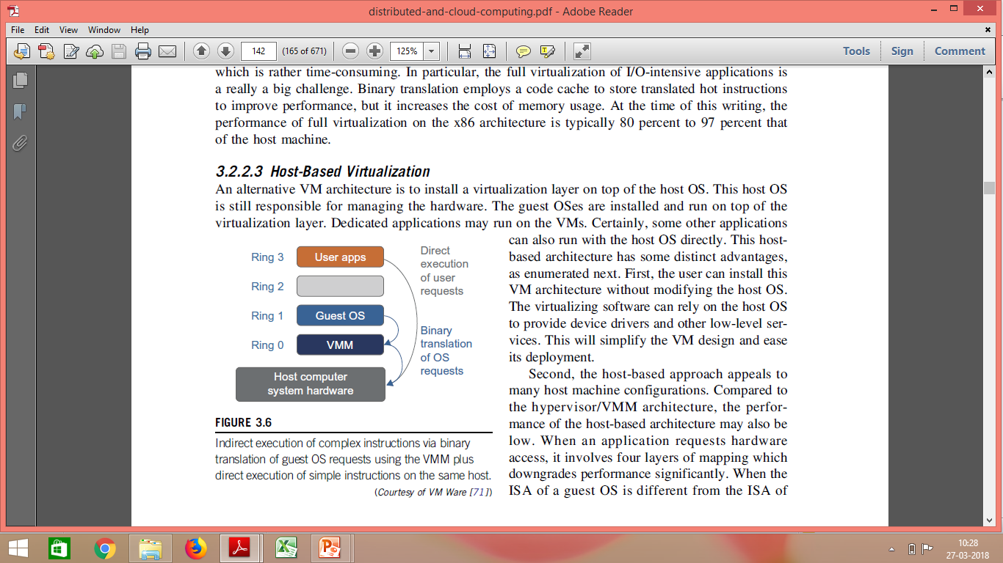
Binary Translation of Guest OS Requests Using a VMM
VMware puts the VMM at Ring 0 and the guest OS at Ring 1.
The VMM scans the instruction stream and identifies the privileged, control- and behavior-sensitive instructions.

Slide 171
Binary Translation of Guest OS Requests Using a VMM
They are trapped into the VMM, which emulates the behavior of these instructions.
The method used in this emulation is called binary translation.

Slide 172
Translation
The trap triggers the
translation of the offending instructions into
an equivalent set of instructions that achieve the same goal without generating exceptions.

Slide 173
Binary Translation of Guest OS Requests Using a VMM
Thus, full virtualization combines binary translation and direct execution.

Slide 174
Binary Translation of Guest OS Requests Using a VMM
The guest OS is completely decoupled from the underlying hardware.
The guest OS is unaware that it is being virtualized.

Slide 175
Full Virtualization
Full virtualization does not need to modify guest OS, and critical instructions are emulated by software through the use of binary translation.
Advantage –
No need to modify OS.
However, this approach of binary translation slows down the performance a lot.
Also binary translation can incur a large performance overhead.

Slide 176
Caching
Binary translation employs a code cache
To store translated hot instructions to improve performance,
To improve efficiency,
the equivalent set of instruction is cached,
so that for further occurrences of the same instructions, translation is not necessary anymore
But it increases the cost of memory usage.

Slide 177
Advantage ?
Disadvantage ?

Slide 178
Advantage
Guests can run unmodified in a virtualized environment.
Binary translation is only applied to a subset of the instruction set, while the others are managed through direct execution on the underlying hardware.
This reduces the impact on performance of binary translation

Slide 179
Disadvantage
Translating instructions at runtime introduces additional overhead that is not present in other approaches like para-virtualization and hardware assisted virtualization.
Rather time-consuming, In particular for the full virtualization of I/O-intensive applications.
The code cache to store translated hot instructions to improve performance, but it increases the cost of memory usage.

Slide 180
Example of FV

Slide 181
VMWARE
Full Virtualization.
Underlying Hardware is made available to the guest operating System which
runs unaware of such abstraction layer and
does not need to be modified.
Guest OS is VMM unaware

Slide 182
Para-Virtualization with Compiler Support

Slide 183
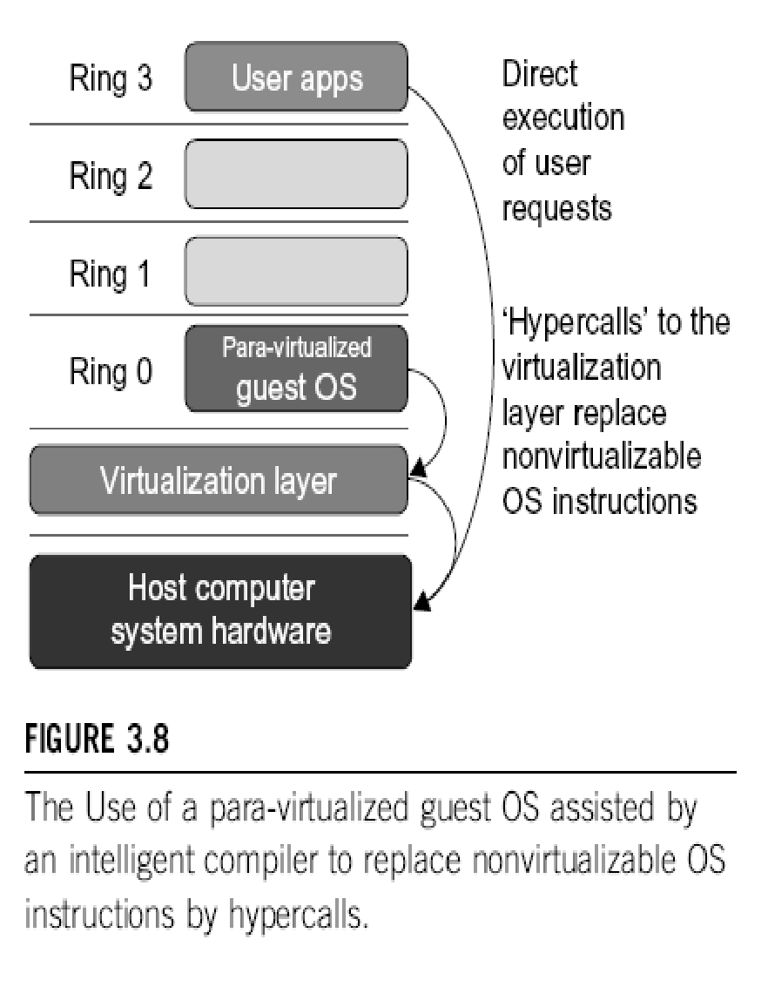
Para-Virtualization with Compiler Support
Para-virtualization needs to modify the guest operating systems.

Slide 184
Para-Virtualization with Compiler Support
A para-virtualized VM provides special APIs requiring substantial OS modifications in user applications.
However, when the guest OS kernel is modified for virtualization, it can no longer run on the hardware directly.

Slide 185
Performance Issue
Performance degradation is a critical issue of a virtualized system.
No one wants to use a VM if it is much slower than using a physical machine.
Para-virtualization attempts to reduce the virtualization overhead, and
thus improve performance by modifying only the guest OS kernel.

Slide 186
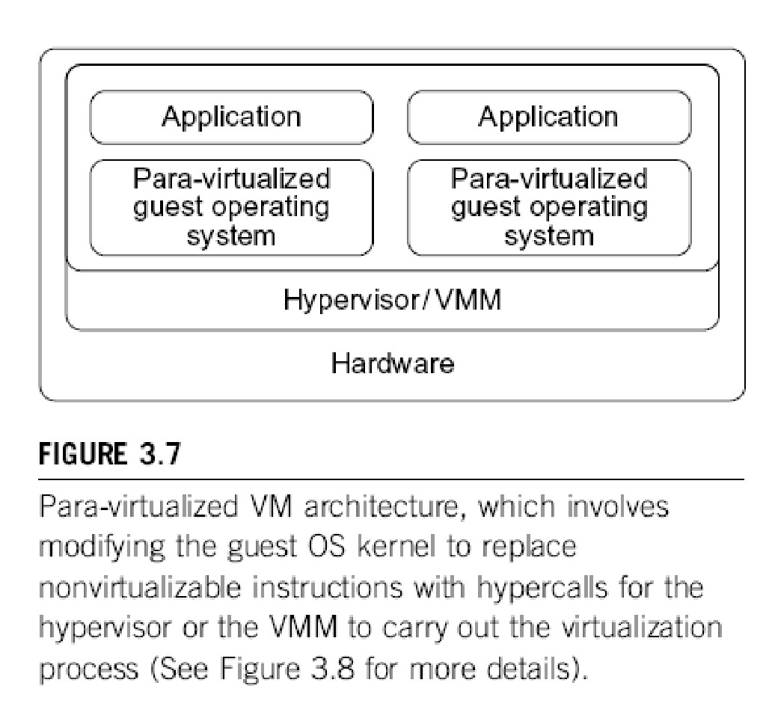
Para-Virtualization: Intelligent Compiler
The guest operating systems are para-virtualized.
They are assisted by an intelligent compiler to replace the non-virtualizable OS instructions by hypercalls that communicate directly with the hypervisor or VMM.

Slide 187
Hypercall
Like syscall is to a kernel.
Hypercall is to a hypervisor
A hypercall is a software trap from a domain to the hypervisor, just as a syscall is a software trap from an application to the kernel.
All are the same thing: a system call to the hypervisor below.
Such calls require support in the "guest" operating system, which has to have hypervisor-specific code to make such calls.

Slide 188
Full Virtualization vs. Para-Virtualization
Full virtualization does not need to modify guest OS, and critical instructions are emulated by software through the use of binary translation.
On the other hand, para virtualization needs to modify guest OS, and non-virtualizable instructions are replaced by hypercalls that communicate directly with the hypervisor or VMM.
Para-Virtualization with Compiler Support
WORK
I
NG

Slide 189
Full Virtualization vs. Para-Virtualization
As of full virtualization, the advantage is no need to modify OS. However, this approach of binary translation slows down the performance a lot.
Para virtualization, reduce the virtualization overhead, and improve performance but the cost of maintaining paravirtualized OS is high. The improvement depends on the workload.

Slide 190
Microsoft Hyper-V
Hyper-V is an infrastructure virtualization solution developed by Microsoft for server virtualization.
As the name recalls, it uses a hypervisor-based approach to hardware virtualization, which leverages several techniques to support a variety of guest operating systems.
Type 1 Hypervisor

Slide 191
Microsoft Hyper-V
Hyper-V is currently shipped as a component of Windows Server 2008 R2 that installs the hypervisor as a role within the server.

Slide 192
Eg-Selecting a server followed by OS in Microsoft Azure

Slide 193
Eg-Selecting a server followed by OS in Microsoft Azure

Slide 194
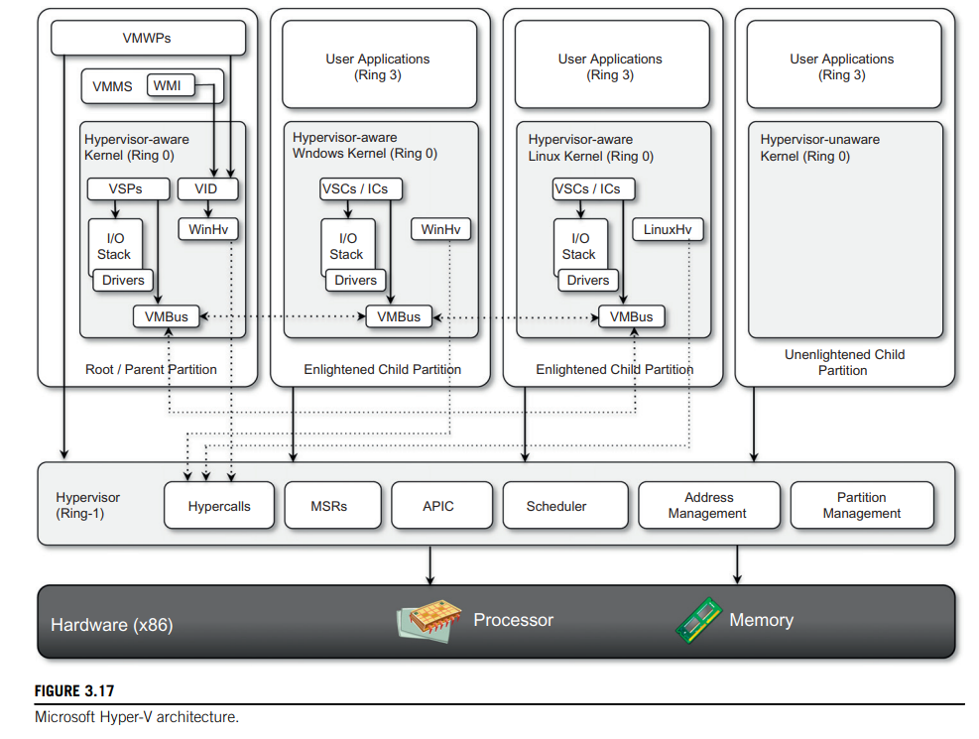
Architecture
Hyper-V supports multiple and concurrent execution of guest operating systems by means of partitions.
A partition is a completely isolated environment in which an operating system is installed and run
Figure provides an overview of the architecture of Hyper-V.

Slide 195
Architecture
Despite its straightforward installation as a component of the host operating system,
Hyper-V takes control of the hardware, and the host operating system becomes a virtual machine instance with special privileges, called the parent partition.

Slide 196
Architecture
The parent partition (also called the root partition)
Is the only one that has direct access to the hardware.
It runs the virtualization stack, hosts all the drivers required to configure guest operating systems, and creates child partitions through the hypervisor.

Slide 197
Architecture
Child partitions are used to host guest operating systems and do not have access to the underlying hardware,
but their interaction with it is controlled by either the parent partition or the hypervisor itself.

Slide 198
Microsoft Hyper-V Hypervisor
The hypervisor is the component that directly manages the underlying hardware (processors and memory).
It is logically defined by the following components:
Hypercalls interface-
Memory service routines (MSRs)-
Advanced programmable interrupt controller (APIC).
Scheduler-
Address manager-
Partition manager-

Slide 199
Microsoft Hyper-V Hypervisor
Hypercalls interface-
This is the entry point for all the partitions for the execution of sensitive instructions.
This is an implementation of the paravirtualization approach

Slide 200
Microsoft Hyper-V Hypervisor
Hypercalls interface-
This interface is used by drivers in the partitioned operating system to contact the hypervisor using the standard Windows calling convention.
The parent partition also uses this interface to create child partitions.

Slide 201
Microsoft Hyper-V Hypervisor
Memory service routines (MSRs)-
These are the set of functionalities that control the memory and its access from partitions.
By leveraging hardware-assisted virtualization, the hypervisor uses the Input/Output Memory Management Unit (I/O MMU or IOMMU) to fast-track access to devices from partitions by translating virtual memory addresses.

Slide 202
Microsoft Hyper-V Hypervisor
Scheduler-
This component schedules the virtual processors to run on available physical processors.
The scheduling is controlled by policies that are set by the parent partition.

Slide 203
Microsoft Hyper-V Hypervisor
Address manager-
This component is used to manage the virtual network addresses that are allocated to each guest operating system.

Slide 204
Microsoft Hyper-V Hypervisor
Partition manager-
This component is in charge of performing partition
creation,
finalization,
destruction,
enumeration, and
configurations.
Its services are available through the hypercalls interface API previously discussed.

Slide 205
Microsoft Hyper-V Hypervisor
Advanced programmable interrupt controller (APIC)-
This component represents the interrupt controller, which manages the signals coming from the underlying hardware when some event occurs
timer expired,
I/O ready,
exceptions and
traps

Slide 206
Microsoft Hyper-V Hypervisor
Advanced programmable interrupt controller (APIC)-
Each virtual processor is equipped with a synthetic interrupt controller (SynIC), which constitutes an extension of the local APIC.

Slide 207
Microsoft Hyper-V Hypervisor
Advanced programmable interrupt controller (APIC)-
The hypervisor is responsible of dispatching the physical interrupts to the synthetic interrupt controllers.
Its services are available through the hypercalls interface API previously discussed.

Slide 208
Microsoft Hyper-V Hypervisor
The hypervisor runs in Ring -1
Therefore requires corresponding hardware technology that enables such a condition.

Slide 209
Microsoft Hyper-V Hypervisor
By executing in this highly privileged mode, the hypervisor can support legacy operating systems that have been designed for x86 hardware.
Operating systems of newer generations can take advantage of the new specific architecture of Hyper-V especially for the I/O operations performed by child partitions

Slide 210
VMware
VMware is a pioneer in virtualization technology
VMware offers a collection of virtualization solutions covering the entire range of the market, from desktop computing to enterprise computing and infrastructure virtualization.

Slide 211
VMware
VMware’s technology is based on the concept of full virtualization
VMware implements full virtualization
Either in the desktop environment, by means of Type II hypervisors, or
In the server environment, by means of Type I hypervisors.
In both cases, full virtualization is made possible by means of
direct execution (for non-sensitive instructions) and
binary translation (for sensitive instructions),

Slide 212
End-user (desktop) virtualization
VMware supports virtualization of operating system environments on enduser computers.

Slide 213
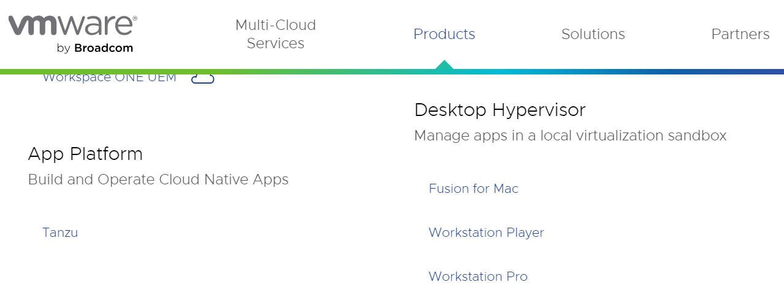
End-user (desktop) virtualization
Specific VMware software—
VMware Workstation, for Windows operating systems, and
VMware Fusion, for Mac OS X environments
Are installed in the host operating system
To create virtual machines and manage their execution.

Slide 214
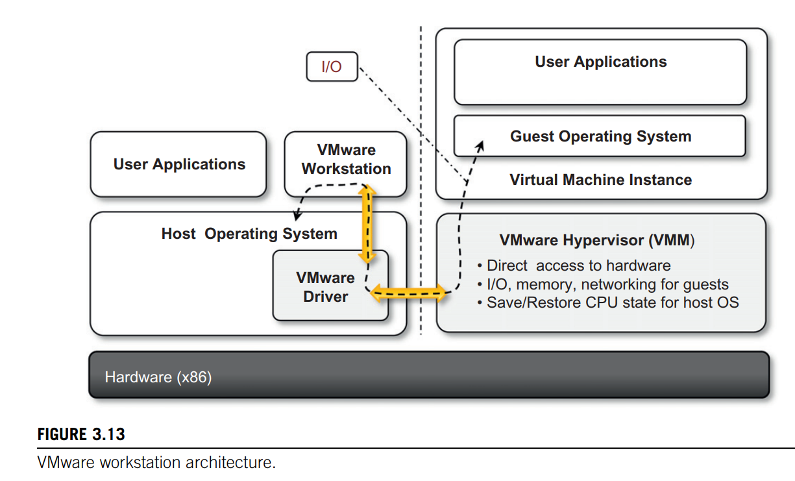
End-user (desktop) virtualization
Virtualization is done by installing a specific driver in the host operating system that provides two main services:

Slide 215
End-user (desktop) virtualization
Two main Services-
It deploys a virtual machine manager that can run in privileged mode.
It provides hooks for the VMware application to process specific I/O requests eventually by relaying such requests to the host operating system via system calls.

Slide 216
Server virtualization
VMware provided solutions for server virtualization with different approaches over time.

Slide 217
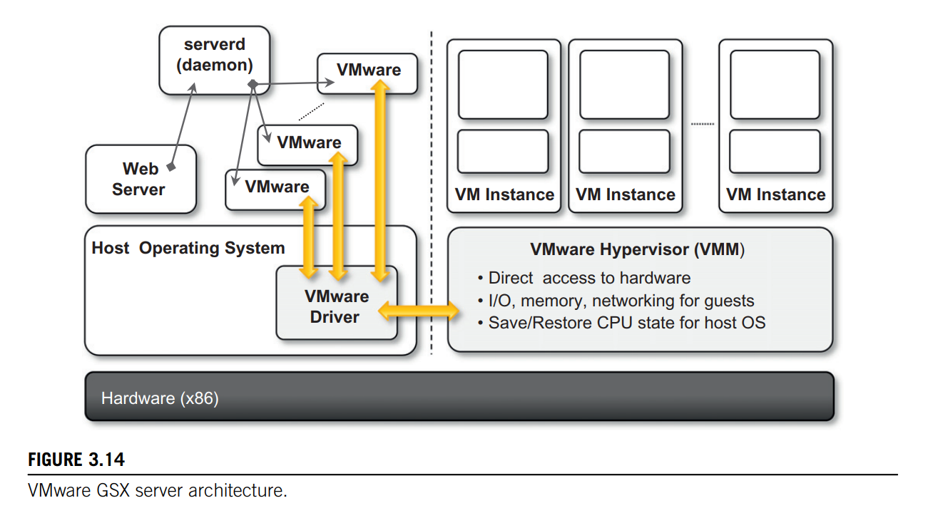
Server virtualization
Initial support for server virtualization was provided by VMware GSX server,
VMware GSX server which replicates the approach used for end-user computers and introduces remote management and scripting capabilities

Slide 218
It uses a client–server model, allowing remote access to virtual machines, at the cost of some graphical performance.

Slide 219
Server virtualization
The architecture is mostly designed to serve the virtualization of Web servers.
A daemon process, called serverd, controls and manages VMware application processes.
The remote host runs a VMware server authentication daemon

Slide 220
Server virtualization
These applications are then connected to the virtual machine instances by means of the VMware driver installed on the host operating system.
Virtual machine instances are managed by the VMM as described previously.

Slide 221
Server virtualization
User requests for virtual machine management and provisioning are routed from the Web server through the VMM by means of serverd.

Slide 222
Server virtualization
VMware ESX Server and its enhanced version, VMWare ESXi-
These two solutions provide the same services but differ in the internal architecture, more specifically in the organization of the hypervisor kernel.
VMware ESX Server and its enhanced version, VMWare ESXi Server, are examples of the hypervisor-based approach.
Both can be installed on bare metal servers and provide services for virtual machine management.

Slide 223
Infrastructure virtualization and cloud computing solutions
VMware provides a set of products covering the entire stack of cloud computing,
from infrastructure management to Software-as-a-Service solutions hosted in the cloud.

Slide 224
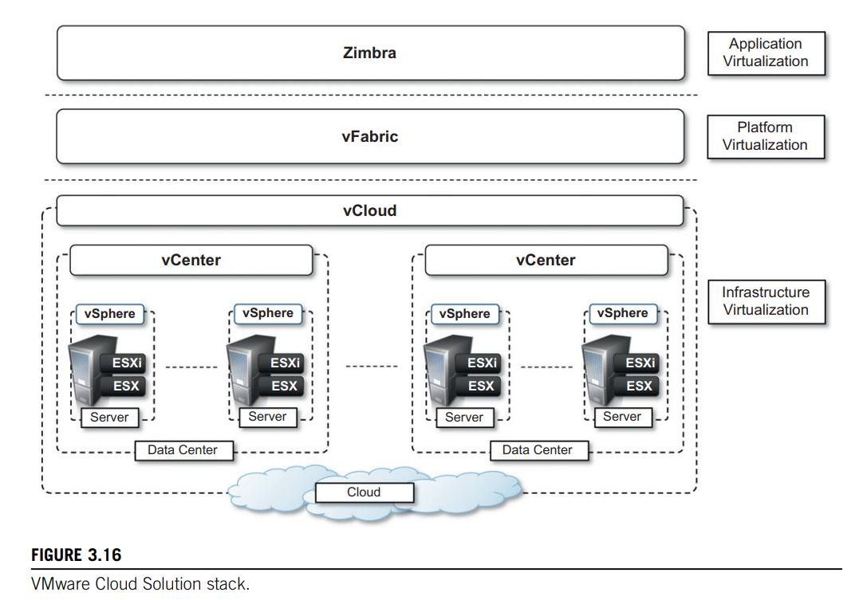
Infrastructure virtualization and cloud computing solutions
Figure 3.16 gives an overview of the different solutions offered and how they relate to each other.

Slide 225
Infrastructure virtualization and cloud computing solutions
ESX and ESXi constitute the building blocks of the solution for virtual infrastructure management:

Slide 226
Infrastructure virtualization and cloud computing solutions
A pool of virtualized servers is tied together and remotely managed as a whole by VMware vSphere.

Slide 227
Infrastructure virtualization and cloud computing solutions
vSphere-
As a virtualization platform it provides a set of basic services besides virtual compute services:
Virtual file system,
virtual storage, and
virtual network
constitute the core of the infrastructure;

Slide 228
Infrastructure virtualization and cloud computing solutions
application services, such as
virtual machine migration,
storage migration,
data recovery, and
security zones, complete the services offered by vSphere.

Slide 229
Infrastructure virtualization and cloud computing solutions
The management of the infrastructure is operated by VMware vCenter,
which provides centralized administration and management of vSphere installations in a data center environment

Slide 230
Infrastructure virtualization and cloud computing solutions
A collection of virtualized data centers are turned into a Infrastructure-as-a-Service cloud by VMware vCloud,
which allows service providers to make available to end users virtual computing environments on demand on a pay-per-use basis.
IAAS

Slide 231
Infrastructure virtualization and cloud computing solutions
A Web portal provides access to the provisioning services of vCloud, and end users can self provision virtual machines by choosing from available templates and setting up virtual networks among virtual instances.

Slide 232
Infrastructure virtualization and cloud computing solutions
VMware also provides a solution for application development in the cloud with VMware vFabric,
vFabric is a set of components that facilitate the development of scalable Web applications on top of a virtualized infrastructure
PAAS

Slide 233
Infrastructure virtualization and cloud computing solutions
vFabric is a collection of components for application monitoring, scalable data management, and scalable execution and provisioning of Java Web applications

Slide 234
Infrastructure virtualization and cloud computing solutions
Finally, at the top of the cloud computing stack, VMware provides Zimbra, a solution for office automation, messaging, and collaboration that is completely hosted in the cloud and accessible from anywhere.
SaaS

Slide 235
Infrastructure virtualization and cloud computing solutions
Zimbra is an SaaS solution that integrates various features into a single software platform providing email and collaboration management.

Slide 236
The cloud reference model
Cloud computing supports any IT service that can be consumed as a utility and delivered through a network, most likely the Internet.
Such characterization includes quite different aspects: infrastructure, development platforms, application and services.

Slide 237
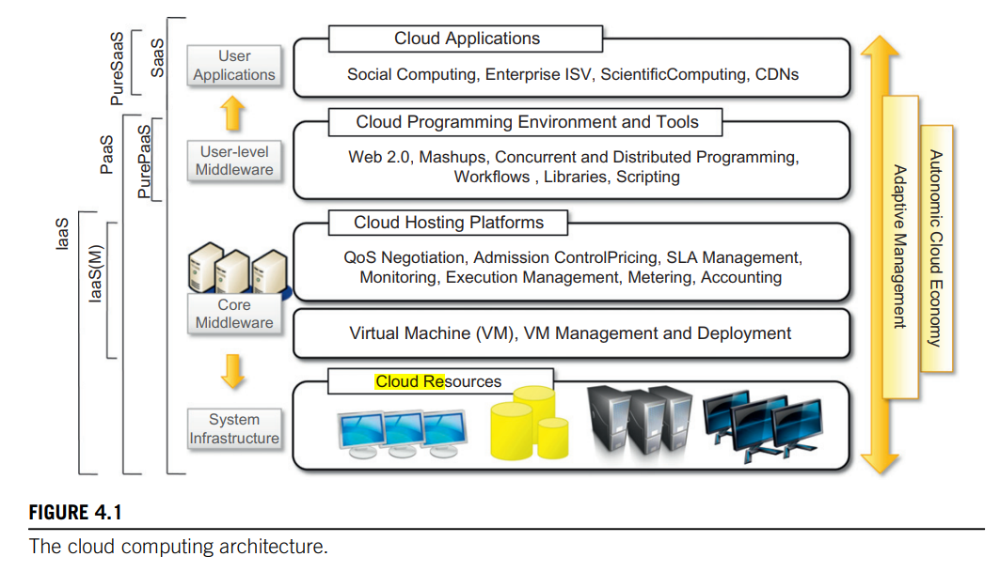
Architecture
It is possible to organize all the concrete realizations of cloud computing into a layered view covering the entire stack from hardware appliances to software systems.

Slide 238
The cloud reference model
Cloud resources -are harnessed to offer “computing horsepower” required for providing services.
Often, this layer is implemented using a datacenter in which hundreds and thousands of nodes are stacked together.

Slide 239
The cloud reference model
Cloud infrastructure can be heterogeneous in nature because a variety of resources, such as clusters and even networked PCs, can be used to build it.
Moreover, database systems and other storage services can also be part of the infrastructure

Slide 240
The cloud reference model
The physical infrastructure is managed by the core middleware,
The objectives of which are to provide an appropriate runtime environment for applications and to best utilize resources

Slide 241
The cloud reference model
Core Middleware-
At the bottom of the stack, virtualization technologies are used to guarantee runtime environment customization, application isolation, sandboxing, and quality of service.
Hypervisors manage the pool of resources and expose the distributed infrastructure as a collection of virtual machines.

Slide 242
The cloud reference model
The combination of cloud hosting platforms and resources is generally classified as a Infrastructure-as-a-Service (IaaS) solution.

Slide 243
The cloud reference model
We can organize the different examples of IaaS into two categories:
Some of them provide both the management layer and the physical infrastructure;
others provide only the management layer (IaaS (M)).

Slide 244
The cloud reference model
In this second case, the management layer is often integrated with other IaaS solutions that provide physical infrastructure and adds value to them.

Slide 245
The cloud reference model
A new layer is formed by cloud programming environments and tools, for offering users a development platform for applications.
The range of tools include Web-based interfaces, command-line tools, and frameworks for concurrent and distributed programming.

Slide 246
The cloud reference model
Platform-as-a-Service (PaaS) because the service offered to the user is a development platform rather than an infrastructure.
PaaS solutions generally include the infrastructure as well, which is bundled as part of the service provided to users.
In the case of Pure PaaS, only the user-level middleware is offered, and it has to be complemented with a virtual or physical infrastructure.

Slide 247
The cloud reference model
The top layer of the reference model depicted in Figure contains services delivered at the application level.
These are mostly referred to as Software-as-a-Service (SaaS). In most cases these are Web-based applications that rely on the cloud to provide service to end users.

Slide 248
Economics of the cloud
The main drivers of cloud computing are economy of scale and simplicity of software delivery and its operation.
In fact, the biggest benefit of this phenomenon is financial: The pay-as-you-go model offered by cloud providers.

Slide 249
Economics of the cloud
In particular, cloud computing allows:
Reducing the capital costs associated to the IT infrastructure
Eliminating the depreciation or lifetime costs associated with IT capital assets
Replacing software licensing with subscriptions
Cutting the maintenance and administrative costs of IT resources

Slide 250
Capital Costs
A capital cost is the cost occurred in purchasing an asset that is useful in the production of goods or the rendering of services.
Capital costs are one-time expenses that are generally paid up front and that will contribute over the long term to generate profit.
The IT infrastructure and the software are capital assets because enterprises require them to conduct their business.

Slide 251
Capital Costs
At present it does not matter whether the principal business of an enterprise is related to IT,
because the business will definitely have an IT department that is used to automate many of the activities that are performed within the enterprise:
payroll,
customer relationship management,
enterprise resource planning,
tracking and inventory of products, and others.
Hence, IT resources constitute a capital cost for any kind of enterprise .

Slide 252
Capital Costs
It is good practice to try to keep capital costs as low as possible
As capital costs are associated with material things they are subject to depreciation over time,
which in the end reduces the profit of the enterprise because such costs are directly subtracted from the enterprise revenues.

Slide 253
Capital Costs
In the case of IT capital costs, the depreciation costs are represented
by the loss of value of the hardware over time and
the aging of software products that need to be replaced because new features are required.

Slide 254
Before cloud computing diffused within the enterprise, the budget spent on IT infrastructure and software constituted a significant expense for medium-sized and large enterprises
Many enterprises owned a small or medium-sized datacenter that introduces several operational costs in terms of maintenance, electricity, and cooling.
Additional operational costs are occurred in maintaining an IT department and an IT support center.
Moreover, other costs are triggered by the purchase of potentially expensive software.

Slide 255
With cloud computing these costs are significantly reduced or simply disappear according to its penetration.

Slide 256
Capital Costs
In terms of the pricing models introduced by cloud computing, we can distinguish three different strategies that are adopted by the providers:
Tiered pricing
Per-unit pricing
Subscription-based pricing

Slide 257
Tiered pricing-
In this model, cloud services are offered in several tiers,
Each of which offers a fixed computing specification and SLA at a specific price per unit of time.
This model is used by Amazon for pricing the EC2 service, which makes available different server configurations in terms of computing capacity (CPU type and speed, memory) that have different costs per hour.

Slide 258
Per-unit pricing-
This model is more suitable to cases where the principal source of revenue for the cloud provider is determined in terms of units of specific services, such as data transfer and memory allocation.
In this scenario customers can configure their systems more efficiently according to the application needs.
This model is used, for example, by GoGrid, which makes customers pay according to RAM/hour units for the servers deployed in the GoGrid cloud.

Slide 259
Subscription-based pricing-
This is the model used mostly by SaaS providers in which users pay a periodic subscription fee for use of the software or the specific component services that are integrated in their applications

Slide 260
Open challenges
Still in its infancy, cloud computing presents many challenges for industry and academia.

Slide 261
Open challenges
Still in its infancy, cloud computing presents many challenges for industry and academia:-
Cloud definition
Cloud interoperability and standards
Scalability and fault tolerance
Security, trust, and privacy
Organizational aspects

Slide 262
Cloud definition
There have been several attempts made to define cloud computing

Slide 263
Cloud definition
One of the most comprehensive formalizations is noted in the NIST working definition of cloud computing .
It characterizes cloud computing as on-demand self-service, broad network access, resource-pooling, rapid elasticity, and measured service; classifies services as SaaS, PaaS, and IaaS; and categorizes deployment models as public, private, community, and hybrid clouds.
The view is shared by many IT practitioners and academicians.

Slide 264
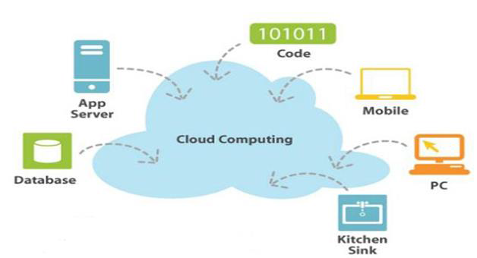
US National Institute of Standards and Technology (NIST) defines Computing as:
“ Cloud computing is a model for enabling ubiquitous, convenient, on-demand network access to a shared pool of configurable computing resources (e.g. networks, servers, storage, applications, and services) that can be rapidly provisioned and released with minimal management effort or service provider interaction. ”

Slide 265
Cloud definition
Despite the general agreement on the NIST definition, there are alternative taxonomies for cloud services.
David Linthicum, founder of BlueMountains Labs, provides a more detailed classification, which comprehends 11 different classes and better suits the vision of cloud computing within the enterprise.

Slide 266
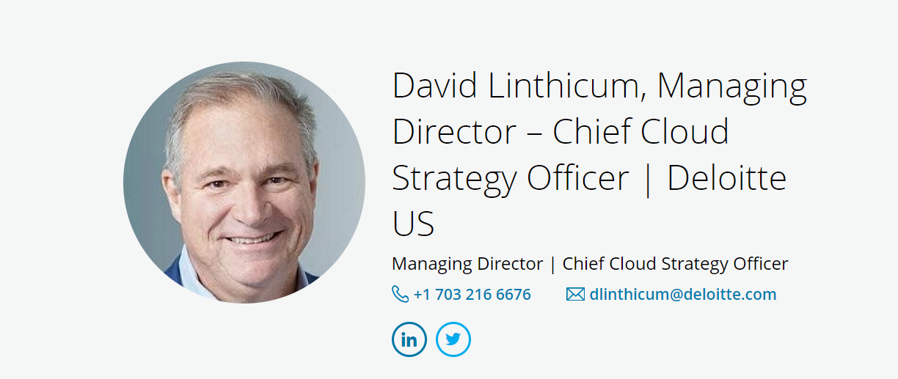
Cloud definition
David S. Linthicum mentions 11 major categories or patterns of cloud computing technology.

Slide 267
David S. Linthicum mentions 11 major categories or patterns of cloud computing technology.
Storage-as-a-service
Database-as-a-service
Information-as-a-service
Process-as-a-service
Application-as-a-service
Platform-as-a-service
Integration-as-a-service
Security-as-a-service
Management/governance-as-a-service
Testing-as-a-service
Infrastructure-as-a-service

Slide 268
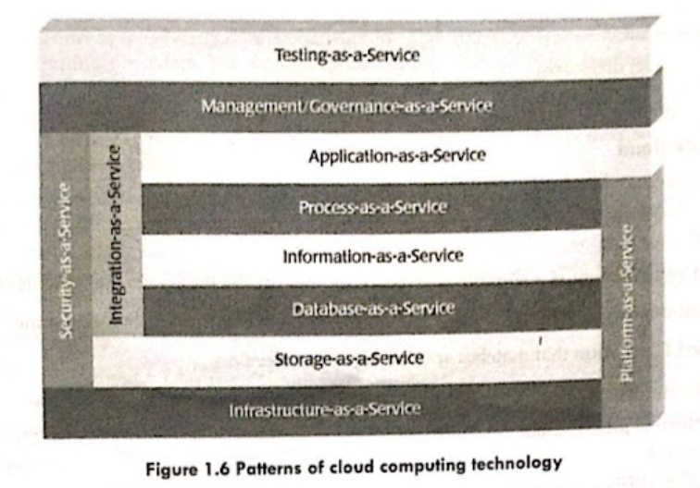
David S. Linthicum mentions 11 major categories or patterns of cloud computing technology.

Slide 269
Cloud definition
A different approach has been taken at the University of California, Santa Barbara (UCSB), which departs from the XaaS concept and tries to define an ontology for cloud computing.

Slide 270
Cloud definition
In their work the concept of a cloud is dissected into five main layers:
applications,
software environments,
software infrastructure,
software kernel, and
hardware.
Each layer addresses the needs of a different class of users within the cloud computing community and most likely builds on the underlying layers

Slide 271
Cloud interoperability and standards
Introducing standards and allowing interoperability between solutions offered by different vendors are objectives of fundamental importance.
Vendor lock-in constitutes one of the major strategic barriers against the seamless adoption of cloud computing at all stages.

Slide 272
Cloud interoperability and standards
Vendor lock-in can prevent a customer from switching to another competitor’s solution, or
when this is possible, it happens at considerable conversion cost and requires significant amounts of time.
This can occur either because the customer wants to find a more suitable solution for customer needs or because the vendor is no longer able to provide the required service.

Slide 273
Cloud interoperability and standards
The current state of standards and interoperability in cloud computing resembles the early Internet era,
when there was no common agreement on the protocols and technologies used and each organization had its own network.

Slide 274
Cloud interoperability and standards
Yet the first steps toward a standardization process have been made, and the following organizations are leading the path
Cloud Computing Interoperability Forum (CCIF),
Open Cloud Consortium, and
DMTF Cloud Standards Incubator

Slide 275
Scalability and fault tolerance
The ability to scale on demand constitutes one of the most attractive features of cloud computing. Clouds allow scaling beyond the limits of the existing in-house IT resources, whether they are infrastructure (compute and storage) or applications services.
To implement such a capability, the cloud middleware has to be designed with the principle of scalability along different dimensions in mind—for example, performance, size, and load.
The cloud middleware manages a huge number of resource and users, which rely on the cloud to obtain the horsepower that they cannot obtain within the premises without bearing considerable administrative and maintenance costs

Slide 276
Security, trust, and privacy
Security, trust, and privacy issues are major obstacles for massive adoption of cloud computing.
The traditional cryptographic technologies are used to prevent data tampering and access to sensitive information.
The massive use of virtualization technologies exposes the existing system to new threats, which previously were not considered applicable.

Slide 277
Security, trust, and privacy
On one side we need to decide whether to trust the provider itself;
On the other side, specific regulations can simply prevail over the agreement the provider is willing to establish with us concerning the privacy of the information managed on our behalf.
Moreover, cloud services delivered to the end user can be the result of a complex stack of services that are obtained by third parties via the primary cloud service provider.

Slide 278
Security, trust, and privacy
In this case there is a chain of responsibilities in terms of service delivery that can introduce more vulnerability for the secure management of data, the enforcement of privacy rules, and the trust given to the service provider.
In particular, when a violation of privacy or illegal access to sensitive information is detected, it could become difficult to identify who is liable for such violations.

Slide 279
Organizational aspects
Cloud computing introduces a significant change in the way IT services are consumed and managed.
More precisely, storage, compute power, network infrastructure, and applications are delivered as metered services over the Internet.
This introduces a billing model that is new within typical enterprise IT departments, which requires a certain level of cultural and organizational process maturity.
In particular, a wide acceptance of cloud computing will require a significant change to business processes and organizational boundaries

Slide 280
Organizational aspects
In particular, the following questions have to be considered:
What is the new role of the IT department in an enterprise that completely or significantly relies on the cloud?
How will the compliance department perform its activity when there is a considerable lack of control over application
What are the implications (political, legal, etc.) for organizations that lose control over some aspects of their services?
What will be the perception of the end users of such services workflows?

